Slide 1
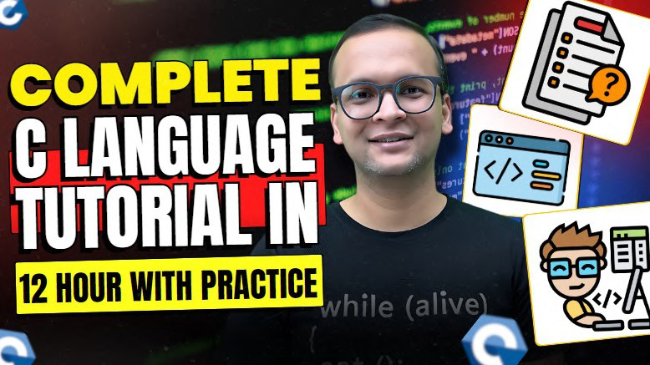

Video Link

Slide 2
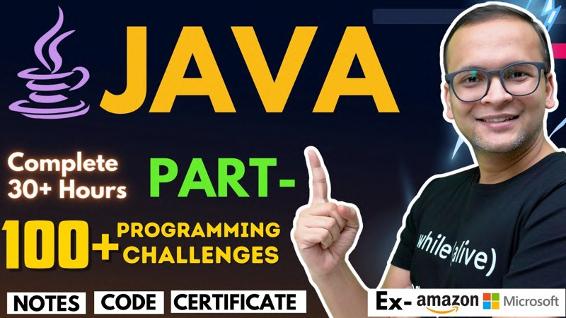


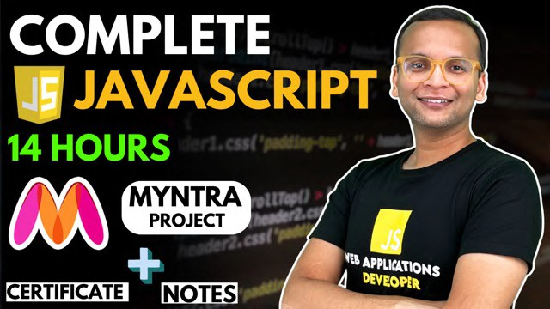





KG Coding
Some Other One shot Video Links:
Complete Java
Complete HTML & CSS
Complete JavaScript
Complete React and Redux
One shot University Exam Series
http://www.kgcoding.in/
Our
Channels
KG Coding Android App
KG Coding
Knowledge GATE
KG Placement Prep
Sanchit Socket

Slide 3

Installation & Compiler Setup
What is IDE
Need of IDE
Windows Installation
Mac Installation

Slide 4

What is IDE
IDE stands for Integrated Development Environment.
Software suite that consolidates basic tools required for software
development.
Central hub for coding, finding problems, and testing.
Designed to improve developer efficiency.

Slide 5
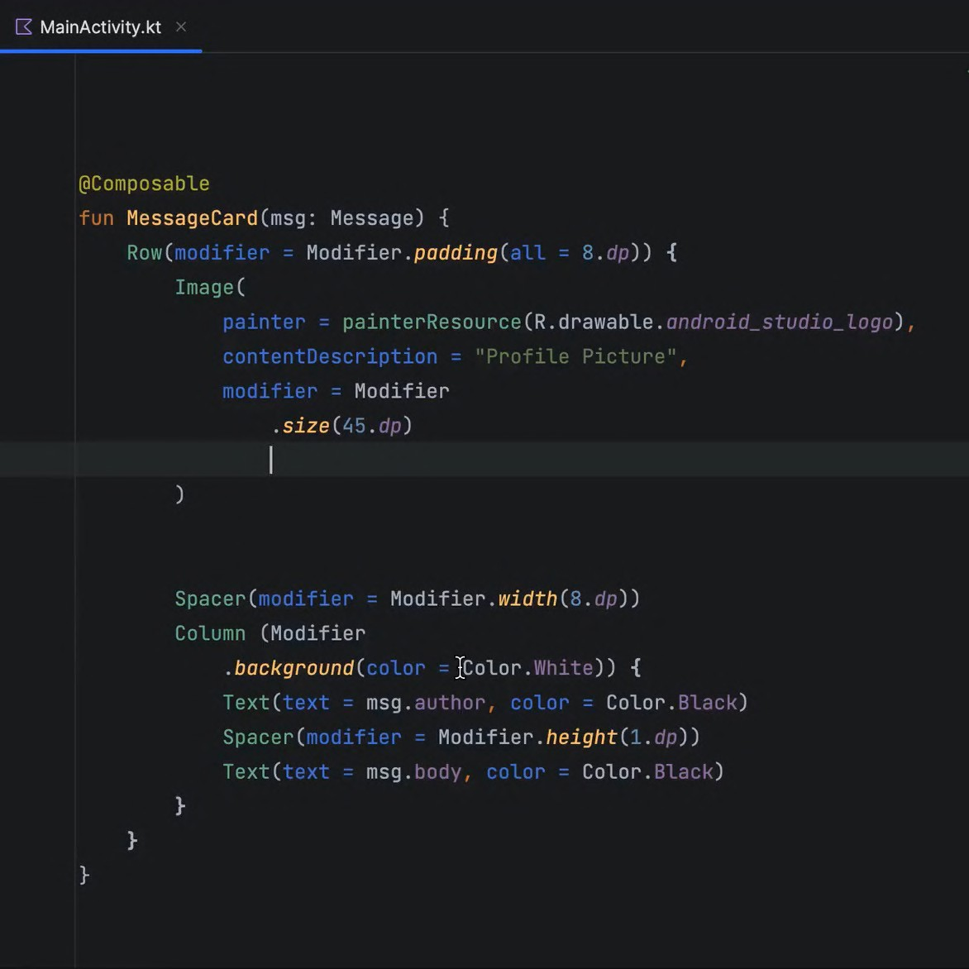
Need of IDE
Streamlines development.
Increases productivity.
Simplifies complex tasks.
Offers a unified workspace.
IDE Features
Code Autocomplete
Syntax Highlighting
Version Control
Error Checking

Slide 6

Installation & Setup

Slide 7

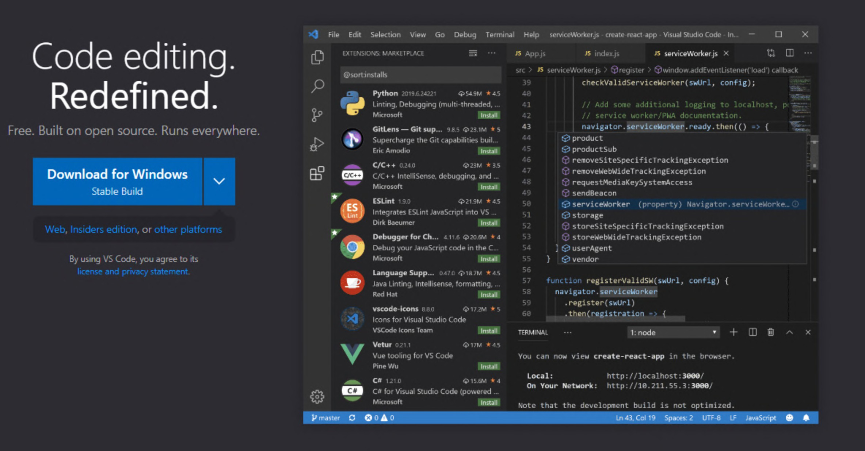
Installing Vs Code
Search VS Code on Google

Slide 8
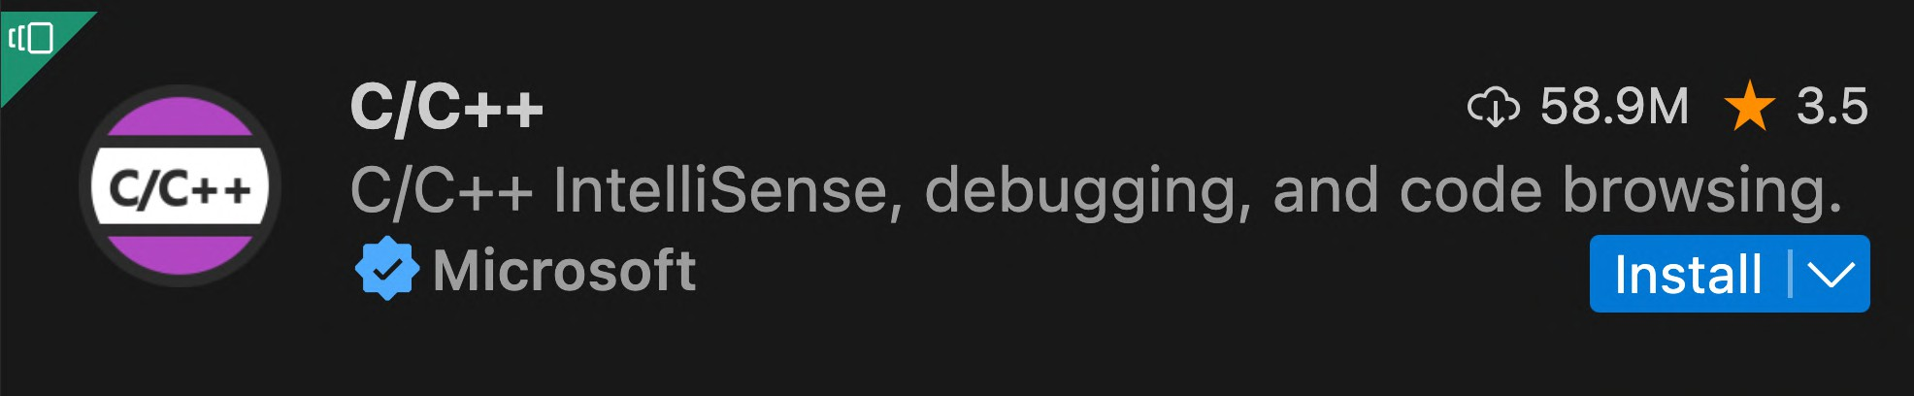
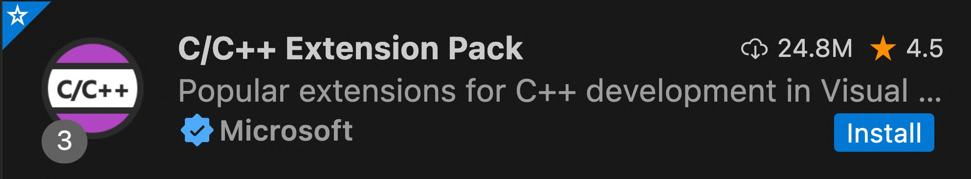
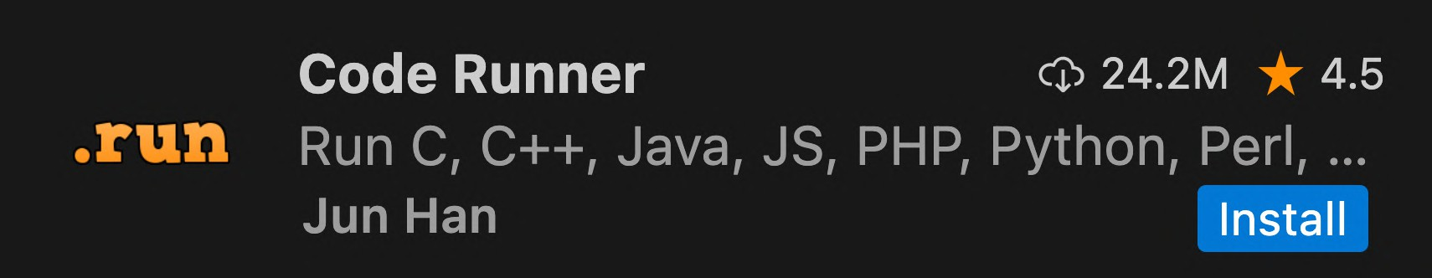
Vs Code Extensions

Slide 9
VsCode Settings
Line Wrap
Tab Size from 4 to 2

Slide 10

Downloading msys-2
https://aka.ms/Install_MinGW

Slide 11
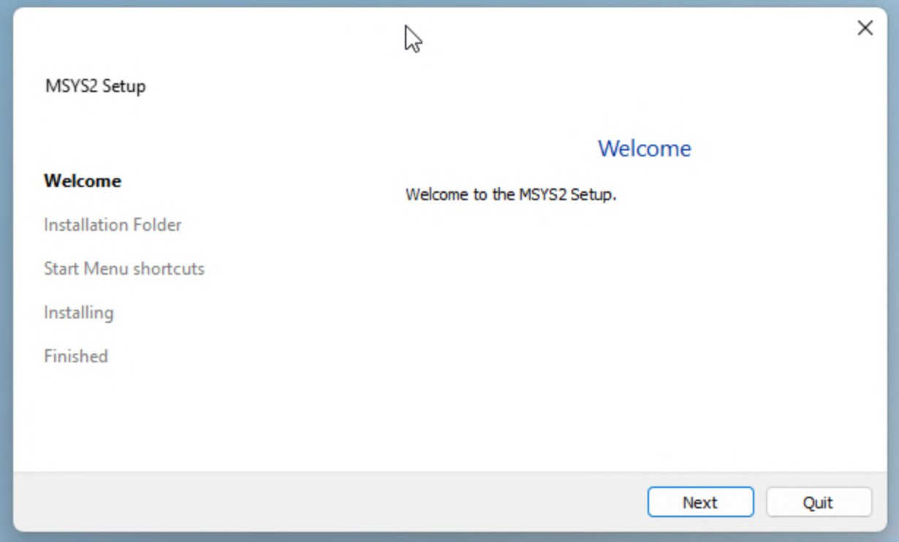
Installing msys-2

Slide 12

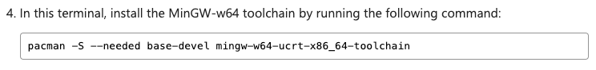
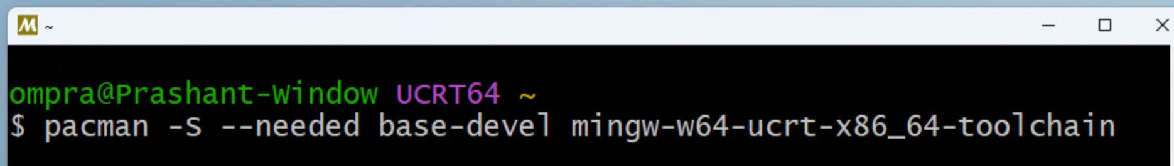
Installing MinGW

Slide 13
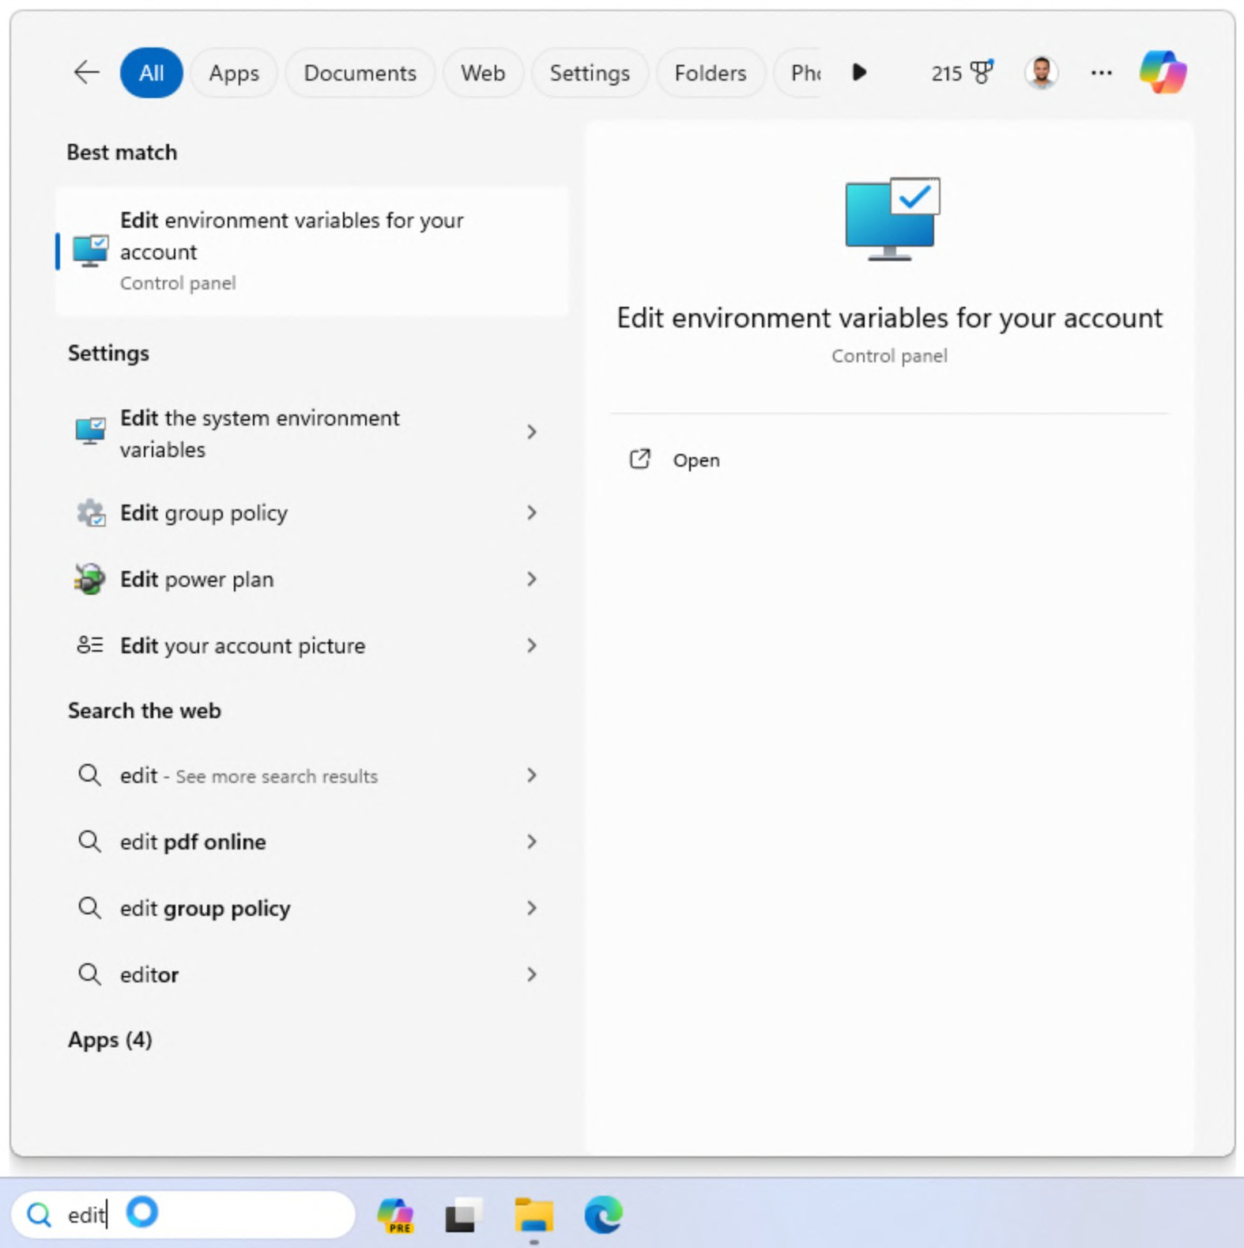
Adding Path

Slide 14
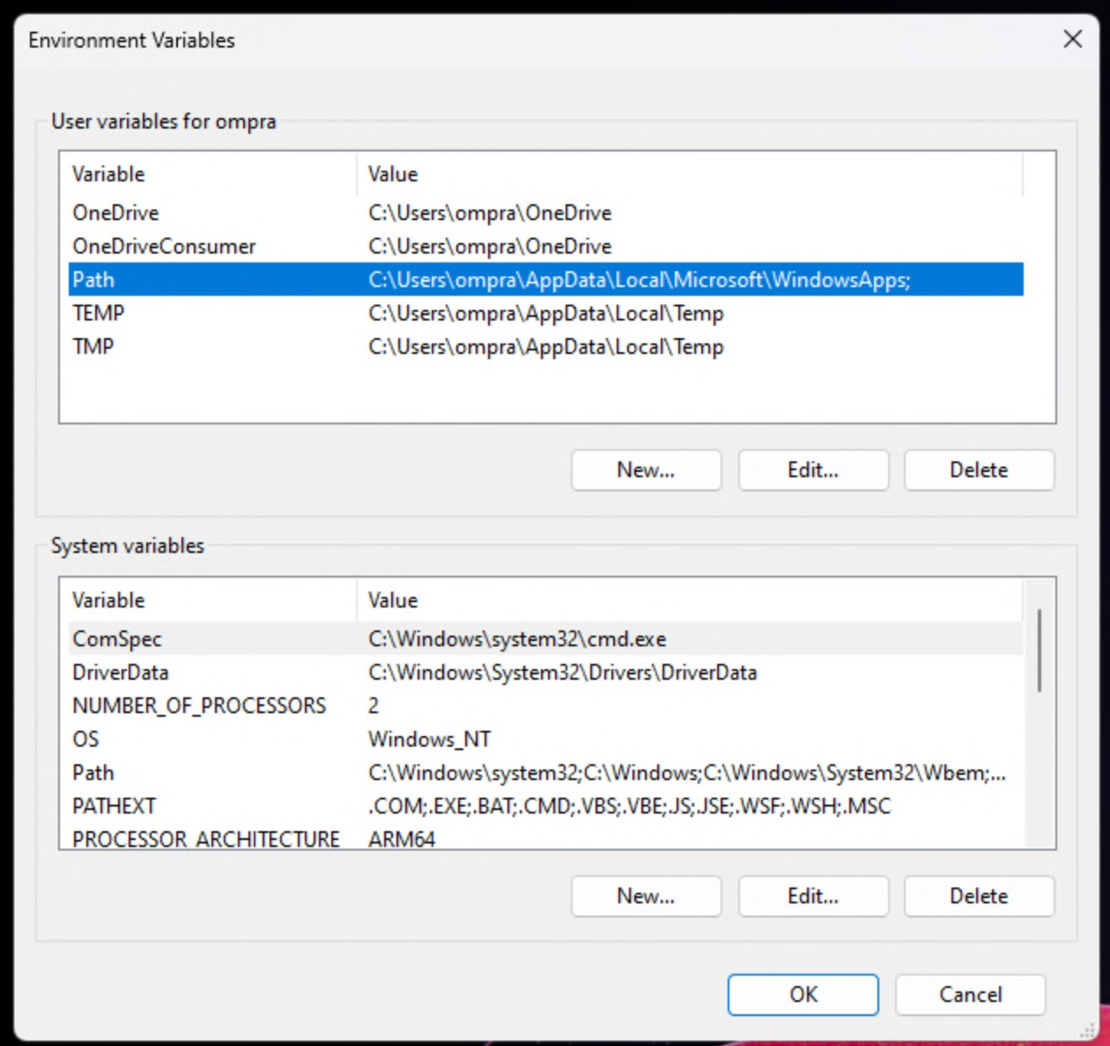
Adding Path

Slide 15
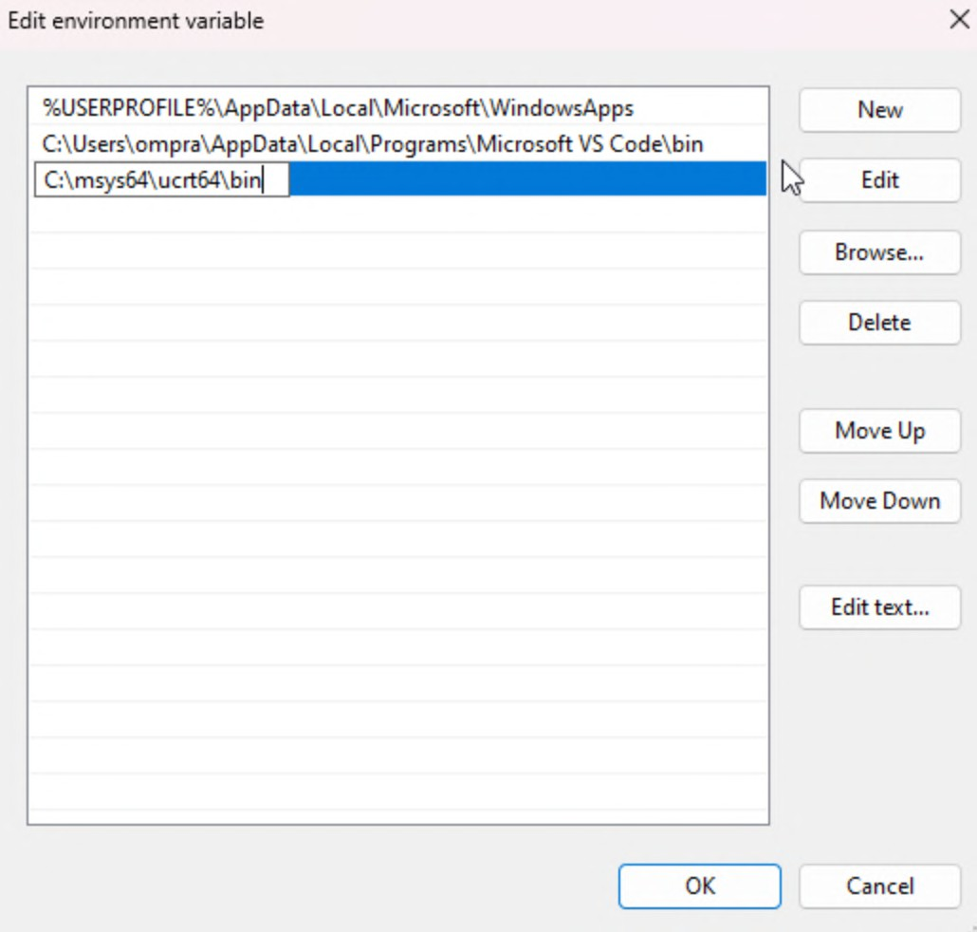
Adding Path

Slide 16
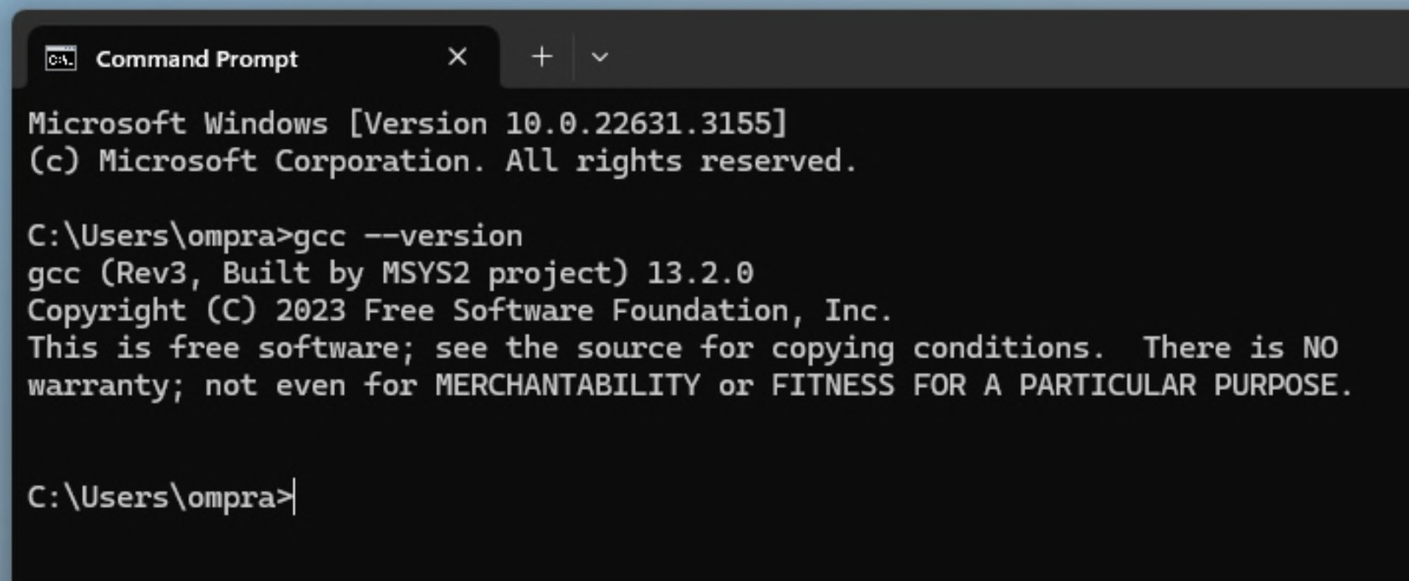
Verifying Path

Slide 17
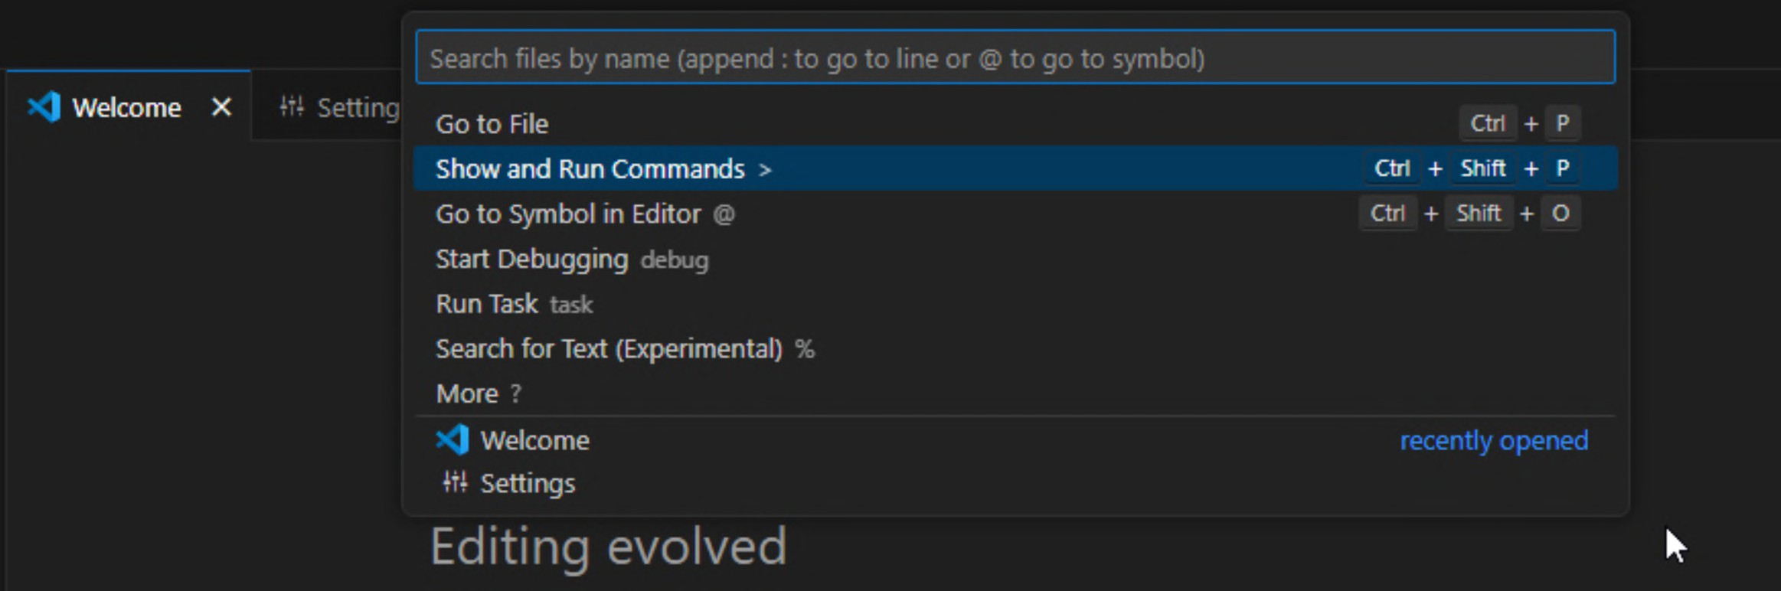
Configuring Path in VS Code

Slide 18
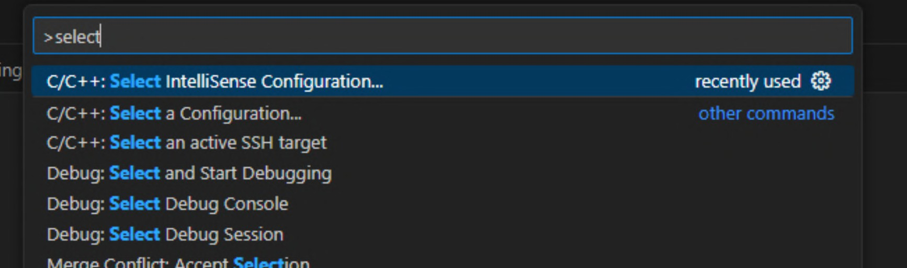
Configuring Path in VS Code

Slide 19
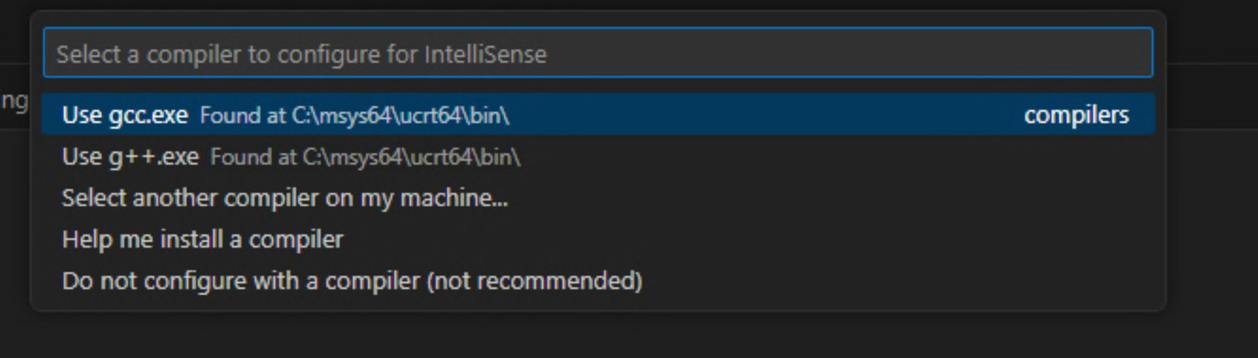
Configuring Path in VS Code

Slide 20

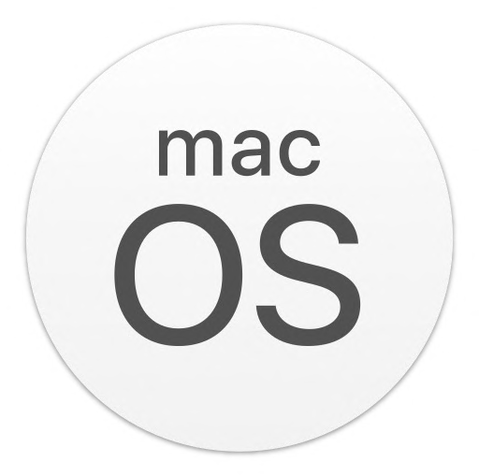
Installation & Setup

Slide 21
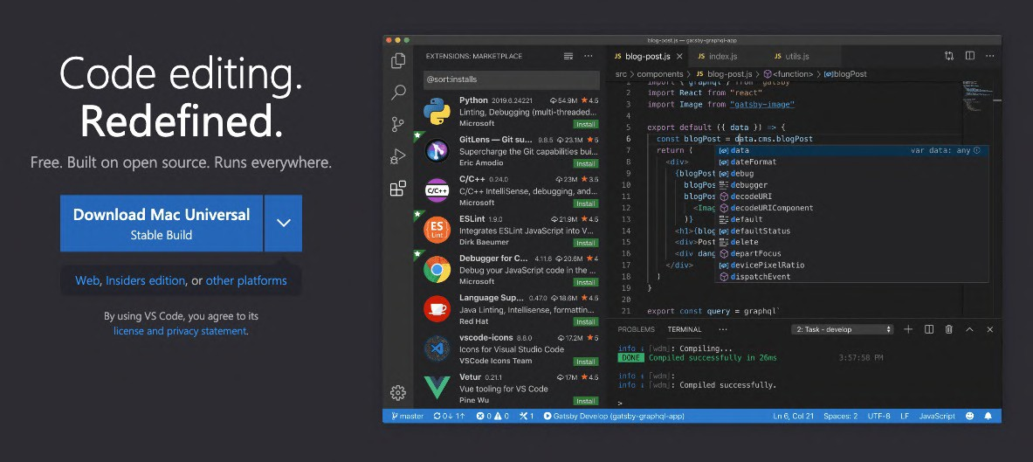
Installing Vs Code
Search VS Code on Google

Slide 22
Vs Code Extensions

Slide 23
VsCode Settings
Line Wrap
Tab Size from 4 to 2

Slide 24
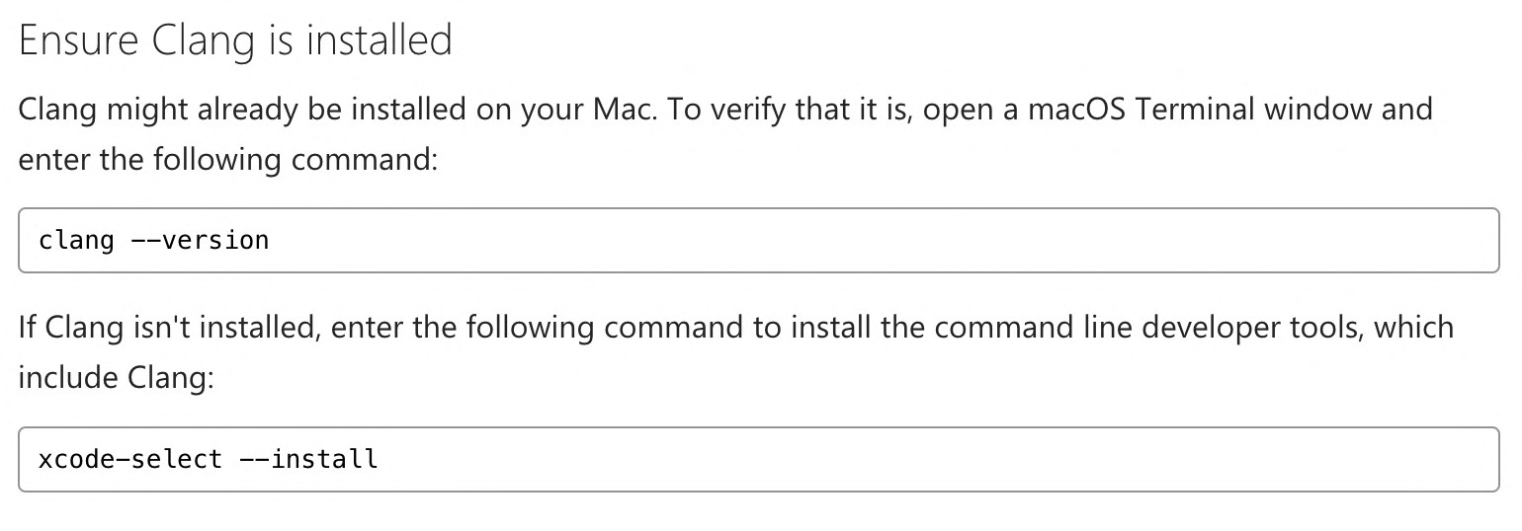
Installing Clang

Slide 25
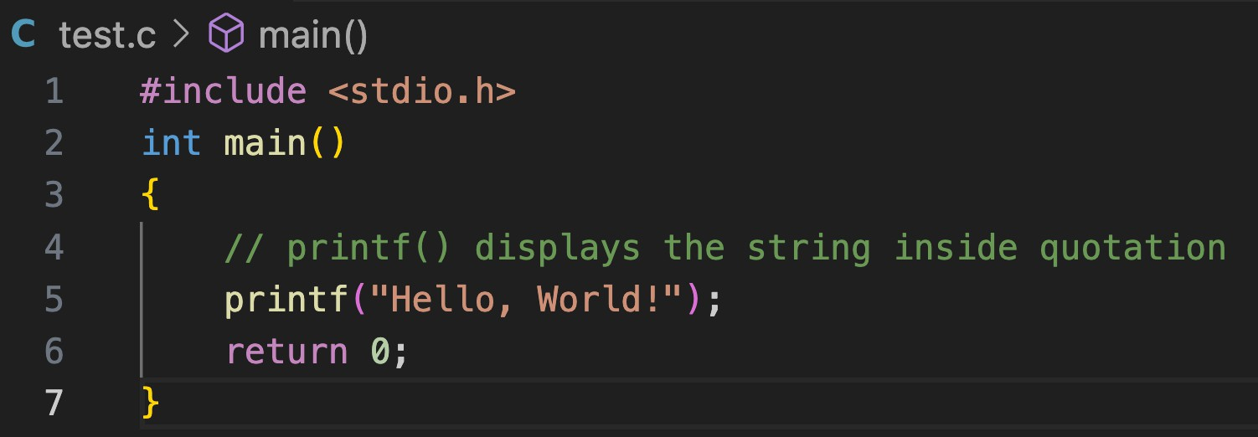
Running Hello World

Slide 26
KG Coding
Some Other One shot Video Links:
Complete Java
Complete HTML & CSS
Complete JavaScript
Complete React and Redux
One shot University Exam Series
http://www.kgcoding.in/
Our
Channels
KG Coding Android App
KG Coding
Knowledge GATE
KG Placement Prep
Sanchit Socket

Slide 27
1. First C Program
Basic Program Structure
Showing output
Importance of main method
File Extension
Comments
Coding using Command line
What is a Programming Language
What is an Algorithm
What is Syntax
What is a Compiler

Slide 28
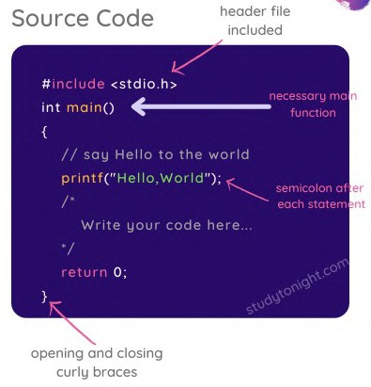


1.1 Basic Program Structure

Slide 29
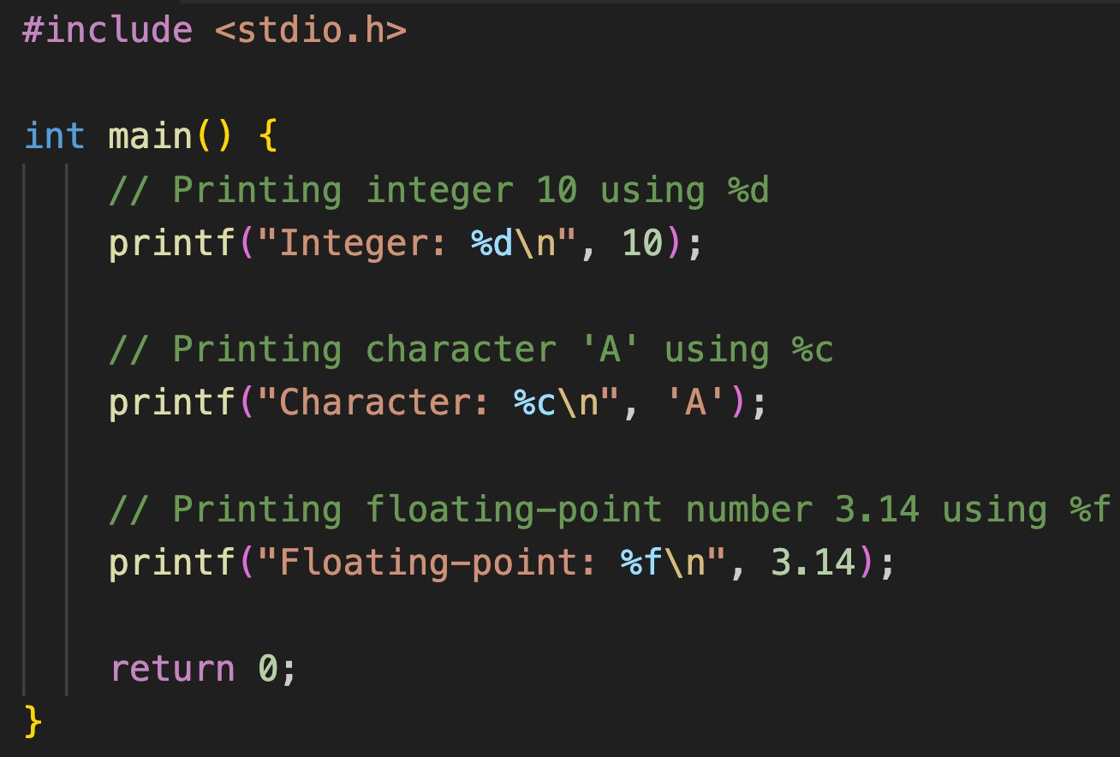
1.2 Showing output
The printf function is used for output. It allows you to display text and variables to the console. Syntax: printf("format string", variable1, variable2, ...);
Displaying Text: To print text, enclose the message in double quotes. printf("Hello, World!");
New Line: Use \n within the string to move to a new line. printf("Hello\nWorld");
Inserting Values: Use format specifiers like:
%d or %i : for integers
%c : for characters
%f : for decimal numbers

Slide 30
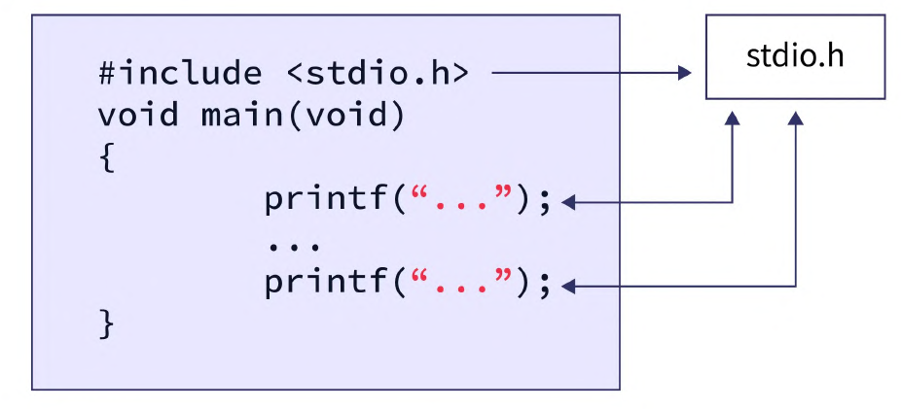
1.3 Importance of the main method
Entry Point: It's the entry point of a C program, where the execution starts. When a C program is executed, the control starts from the main function.
Required: Every executable C program must have a main function.
Return Type: Typically returns int, indicating program success (0) or error (non-zero) to the operating system.
Fixed Name: The name main is recognized by C compilers as the program's starting point.

Slide 31
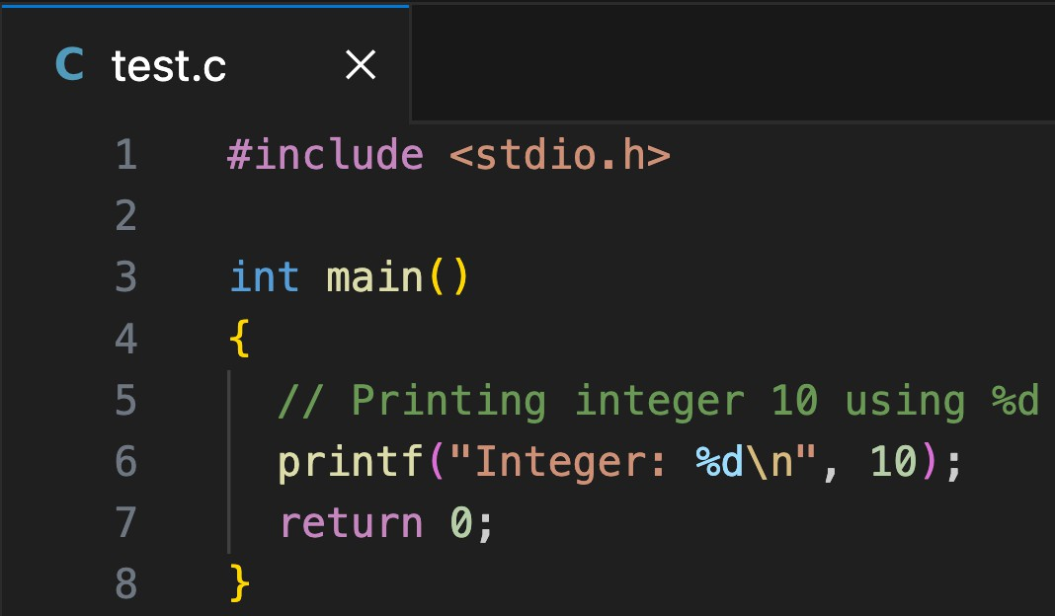
1.4 File Extension
.c
Contain Executable Code
Compiled: Transformed into executable programs.
Often hosts the main
Contain Declarations for code to be shared.
Improve modularity and manageability in projects.
Facilitate code use across multiple .c files without duplication.
.h

Slide 32

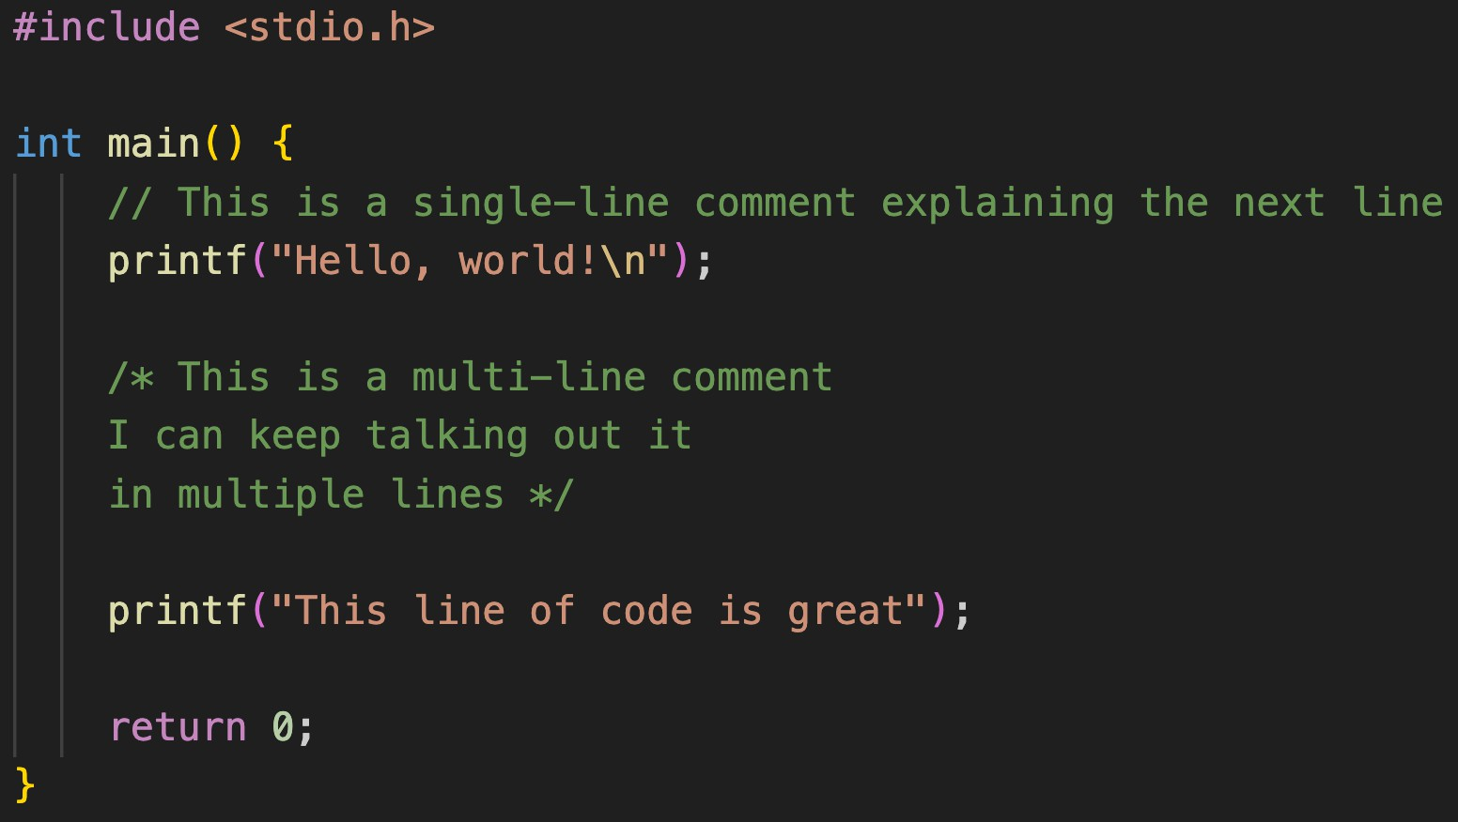
1.5 Comments
Used to add notes in C code
Not considered as part of code
Helpful for code organization
Syntax:
Single Line: //
Multi Line: /* */

Slide 33
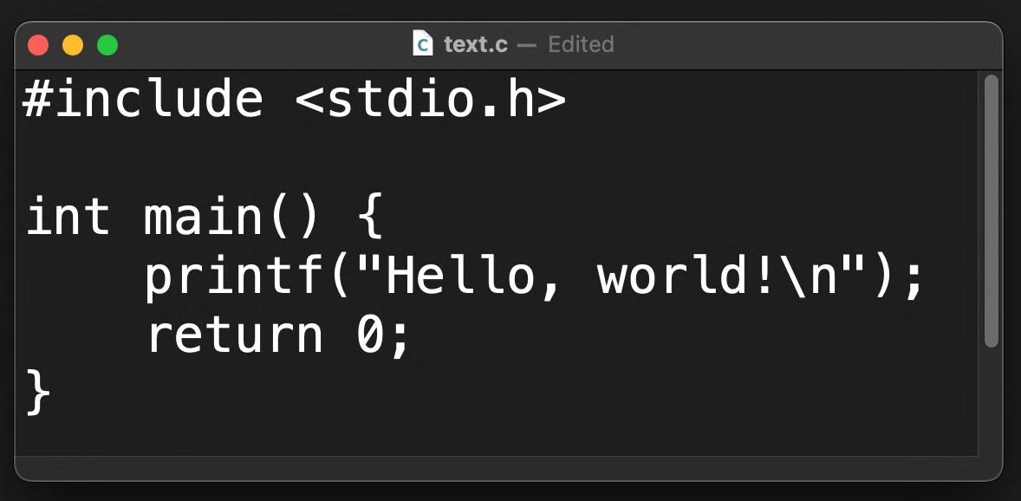
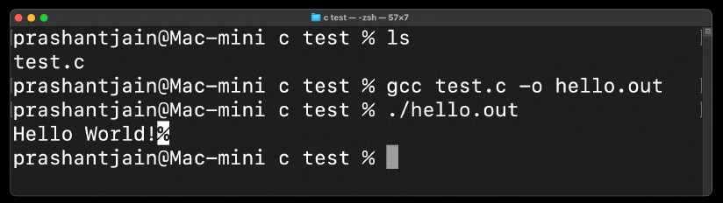
1.6 Coding using Command line
Coding
Write code using a text editor
Save the file with a .c extension
Compiling and running
Use gcc file –o outputname command to compile.
Run the output file using:
On Windows: .\outputname
On macOS/Linux: ./outputname

Slide 34

1.7 What is a Programming Language
Humans use natural language (like Hindi/English) to communicate

Slide 35

1.7 What is a Programming Language
Computers only understand 0/1 or on/off

Slide 36
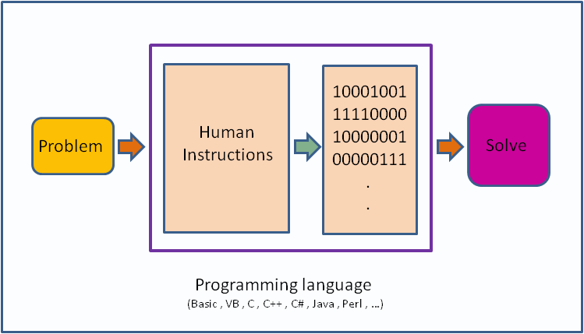
1.7 What is a Programming Language
Giving instructions to a computer
Instructions: Tells computer what to do.
These instructions are called code.
Human instructions are given in High level languages.
Compiler converts high level languages to low level languages or machine code.

Slide 37
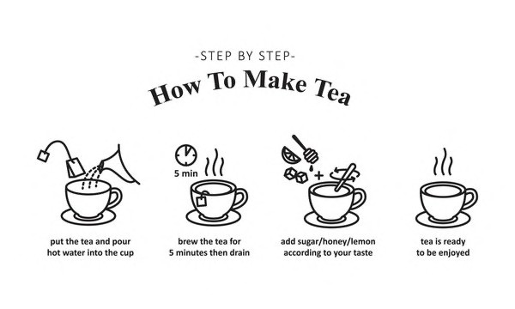
1.8 What is an Algorithm

Slide 38
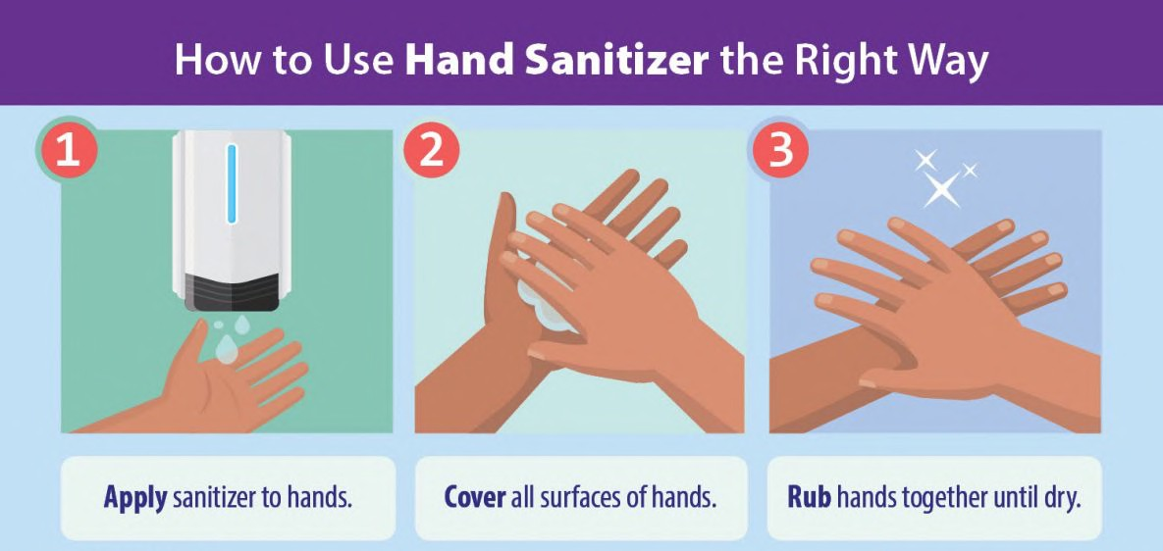
1.8 What is an Algorithm
An algorithm is a step-by-step procedure for solving a problem or performing a task.

Slide 39

1.9 What is Syntax
Structure of words in a sentence.
Rules of the language.
For programming exact syntax must be followed.

Slide 40
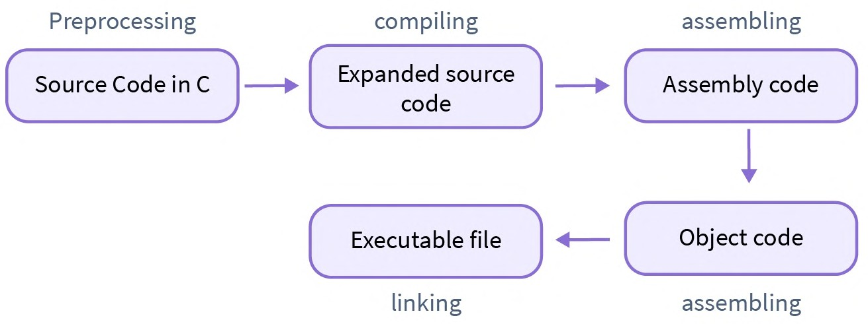
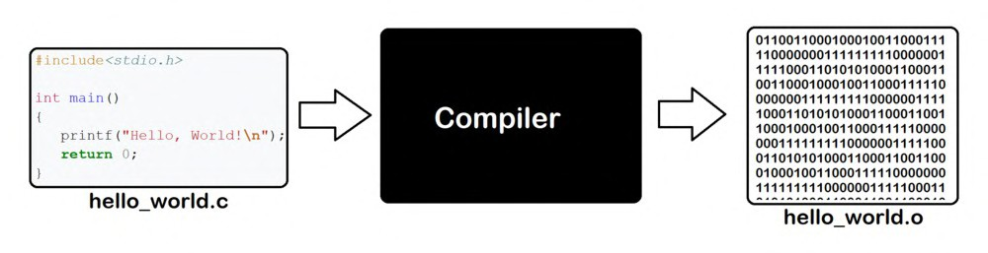
1.10 What is a Compiler
Pre-processing: Processes directives (like #include and #define) before compilation, modifying the source code according to these instructions.
Compiling: Transforms source code written in a high-level language (like C) into assembly language.
Assembling: Converts assembly language into machine code, generating object files.
Linking: Combines multiple object files into a single executable or
library, resolving references between them.

Slide 41

Revision
Basic Program Structure
Showing output
Importance of main method
File Extension
Comments
Coding using Command line
What is a Programming Language
What is an Algorithm
What is Syntax
What is a Compiler

Slide 42
KG Coding
Some Other One shot Video Links:
Complete Java
Complete HTML & CSS
Complete JavaScript
Complete React and Redux
One shot University Exam Series
http://www.kgcoding.in/
Our
Channels
KG Coding Android App
KG Coding
Knowledge GATE
KG Placement Prep
Sanchit Socket

Slide 43
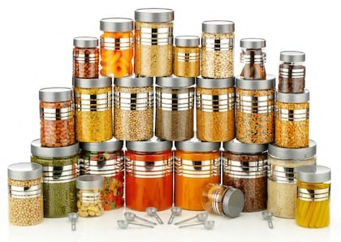
2 Variables, Data Types & Input/Output
Variables
Data Types
Naming Conventions
Literals
Constants
Keywords
Escape Sequences
User Input using Scanf
Sum of Two Numbers

Slide 44
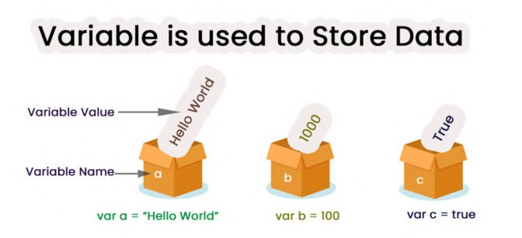
2.1 What are Variables?
Variables are like containers used for storing data values.

Slide 45
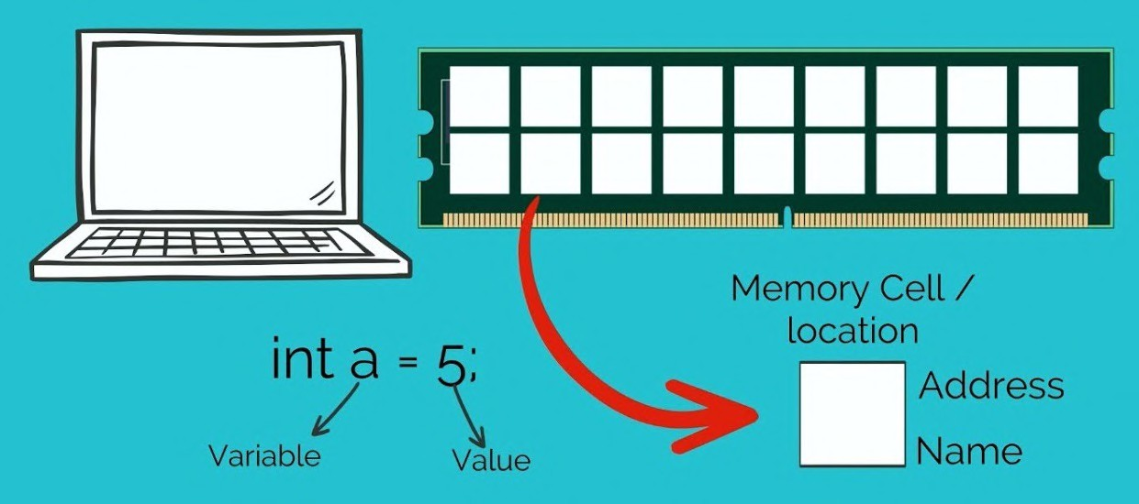
2.1 Memory Allocation

Slide 46
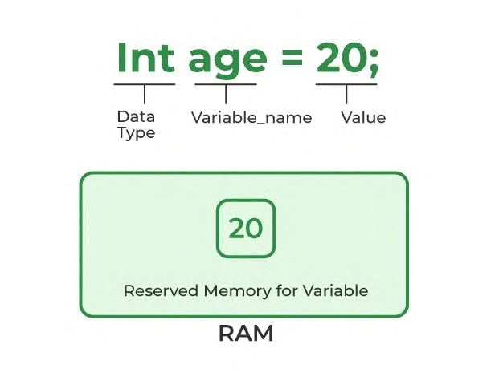
2.1 Variable Declaration

Slide 47
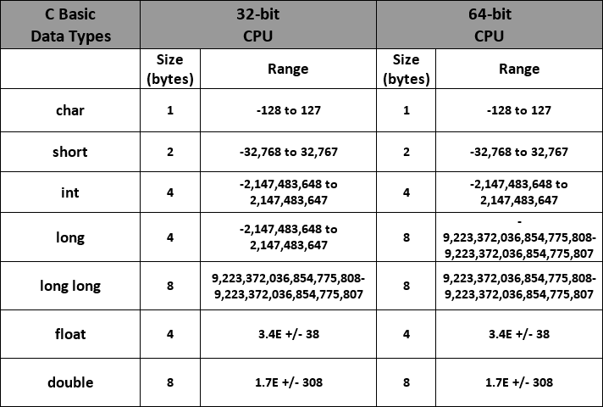
2.2 Data Types

Slide 48
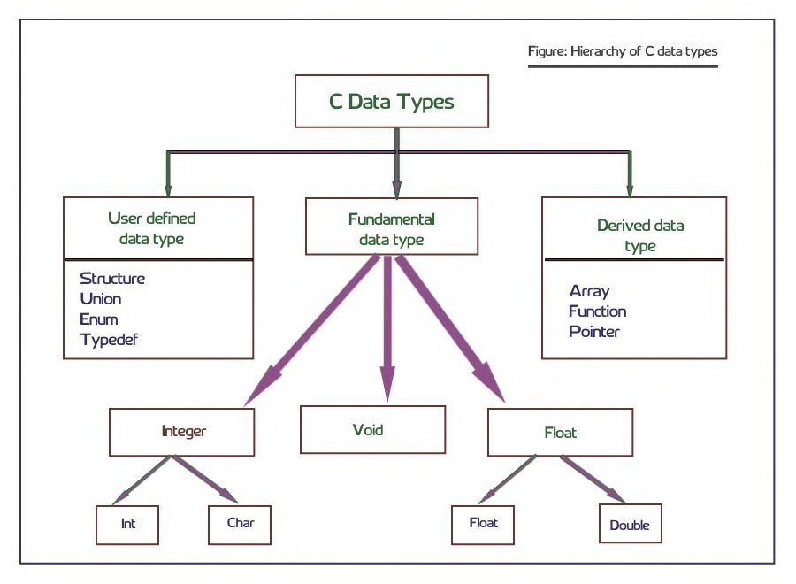
2.2 Data Types

Slide 49
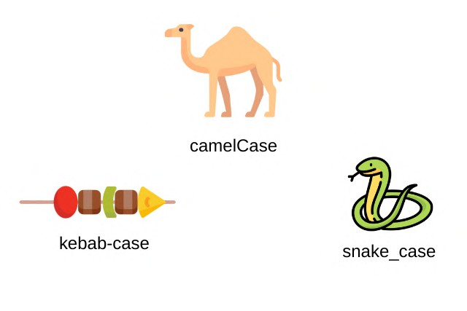
2.3 Naming Conventions
camelCase
Start with a lowercase letter. Capitalize the first letter of each subsequent word.
Example: myVariableName
snake_case
Start with an lowercase letter. Separate words with underscore
Example: my_variable_name
Kebab-case
All lowercase letters. Separate words with hyphens. Example: my-variable-name
Keep a Good and Short Name
Choose names that are descriptive but not too long. It should
make it easy to understand the variable's purpose.
Example: age, first_name, is_married

Slide 50
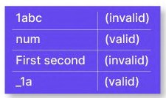
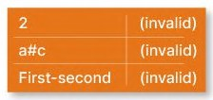
2.3 C Identifier Rules
The only allowed characters for identifiers are all alphanumeric characters([A-Z],[a-z],[0- 9]), and ‘_‘ (underscore).
Can’t use keywords or reserved words
Identifiers should not start with digits([0-9]).
C identifiers are case-sensitive.
There is no limit on the length of the identifier but it is advisable to use an optimum length of 4 – 15 letters only.

Slide 51
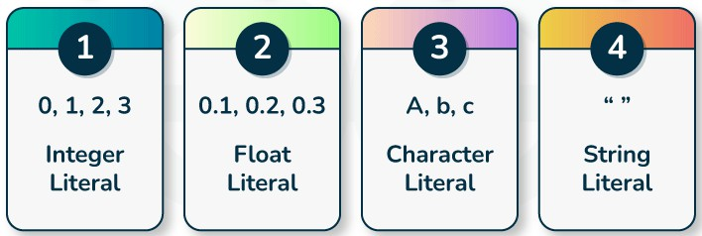
2.4 Literals

Slide 52
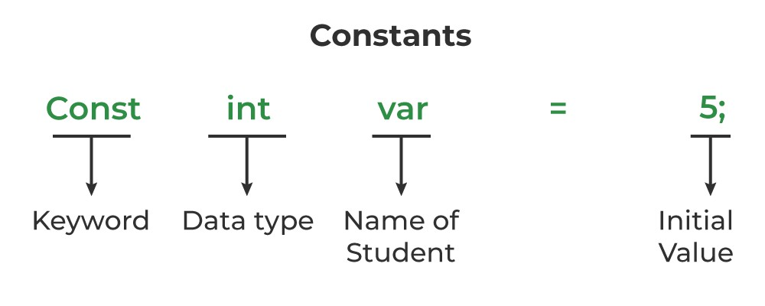
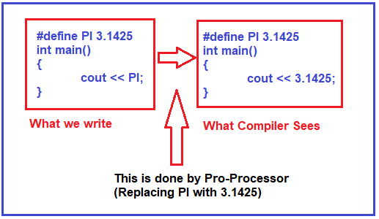
2.5 Constants
Fixed values in C code that do not change during execution.
Constants are defined using #define or const (e.g., #define PI 3.1425).
Enhances code readability and eases modifications.
Constants are immutable.

Slide 53
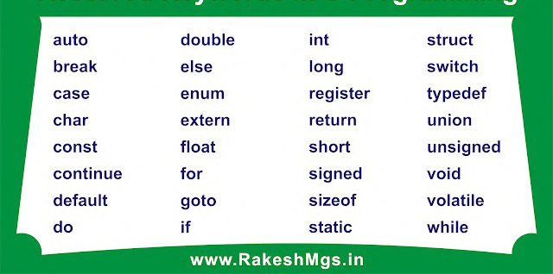
2.6 Keywords

Slide 54
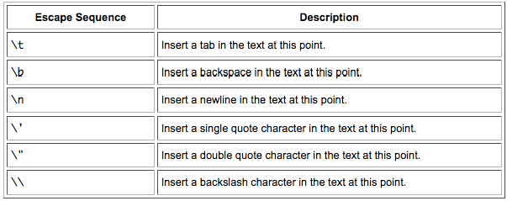
2.7 Escape Sequences

Slide 55
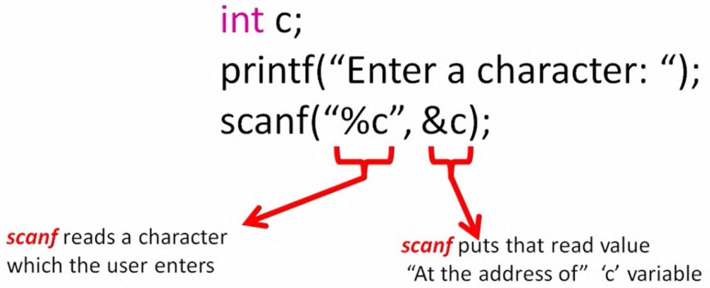
2.8 User Input using scanf
scanf is used for reading formatted input.
Syntax: scanf("format specifier", &variable);
Use format specifiers (e.g., %d for integers) to define the input type.
Address Operator: Prefix variables with &, except
for arrays and strings.

Slide 56
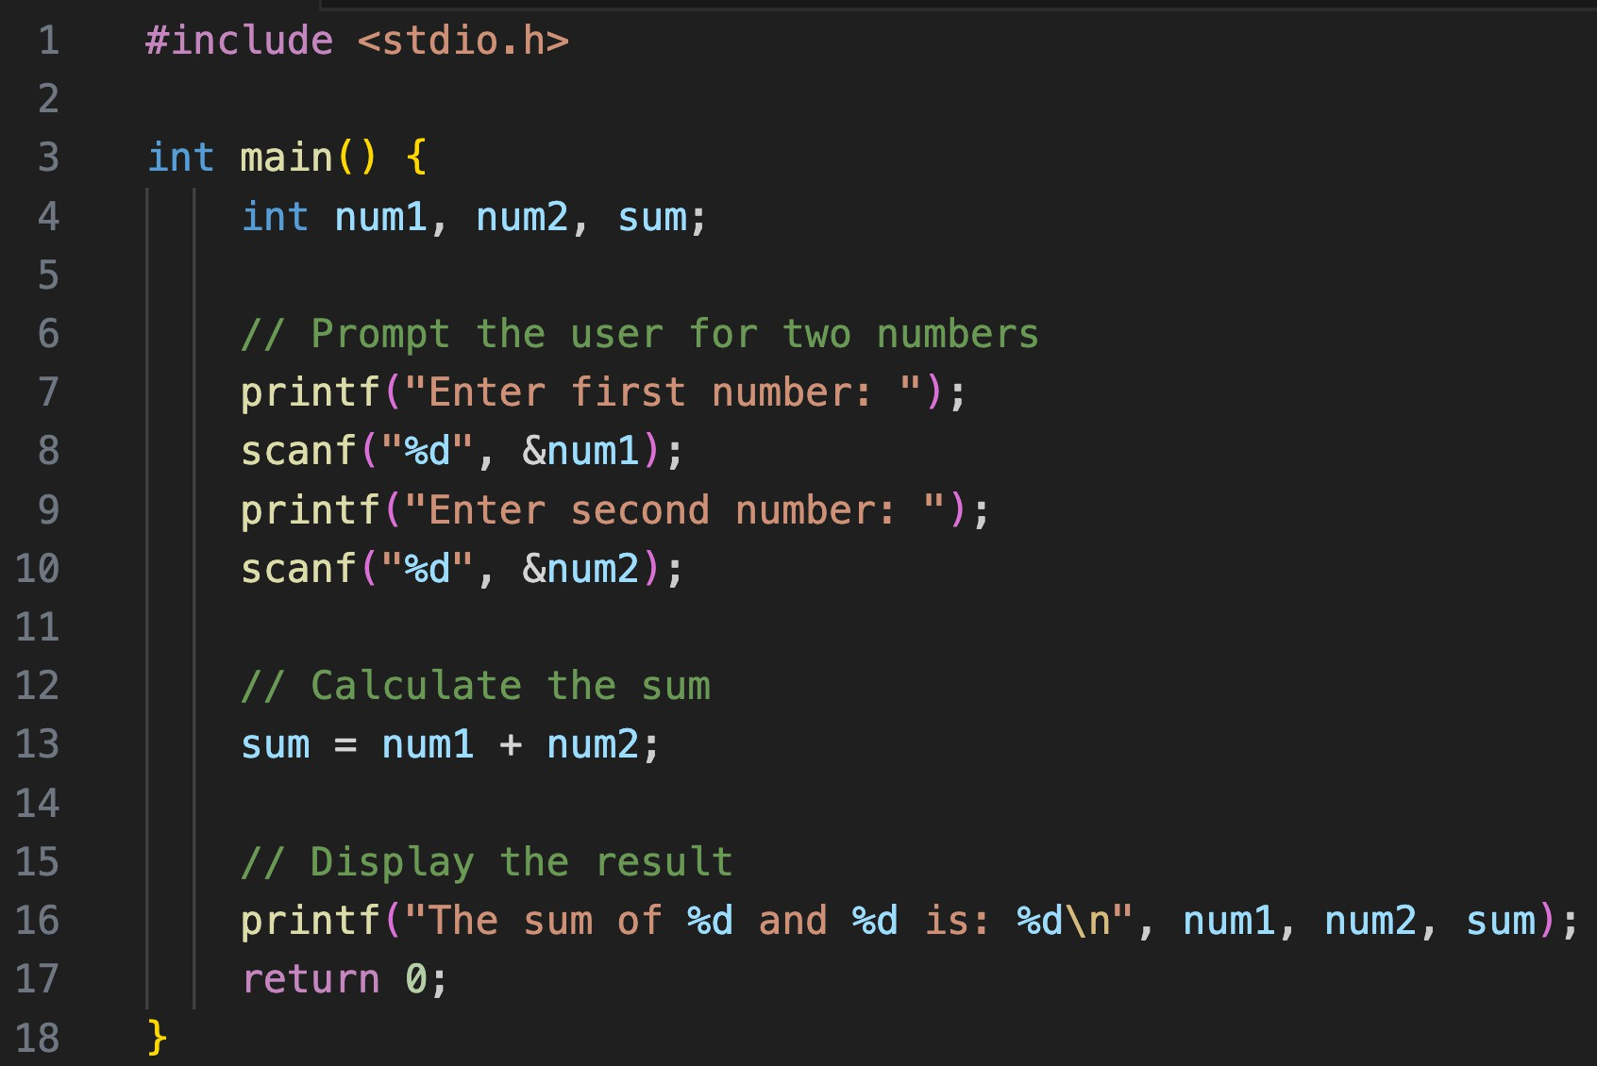
2.9 Sum of Two Numbers

Slide 57
Revision
Variables
Data Types
Naming Conventions
Literals
Constants
Keywords
Escape Sequences
User Input using Scanf
Sum of Two Numbers

Slide 58



Tasks:
1.Show the following patterns just using print statements:
2.Show the following patterns using single print statement:

Slide 59
Create a program to input name of the person and respond with ”Welcome NAME to KG Coding”
Create a program to declare two integer variables, assign them
values, and display their values.
Create a program that declares one variable of each of the fundamental data types (int, float, double, char) and prints their size using sizeof() operator.
Define variables for storing a user's first name, last name, and age
using appropriate naming conventions and then display them.
Create a program to print the area of a square by inputting its side length
Create a program to define a constant for the mathematical value
pi (3.14159) and use it to calculate and print the circumference of a
circle with a radius input from user.
Create a program to print the area of a circle by inputting its radius.
Create a program to swap two numbers.

Slide 60
KG Coding
Some Other One shot Video Links:
Complete Java
Complete HTML & CSS
Complete JavaScript
Complete React and Redux
One shot University Exam Series
http://www.kgcoding.in/
Our
Channels
KG Coding Android App
KG Coding
Knowledge GATE
KG Placement Prep
Sanchit Socket

Slide 61

3. Instructions, Expressions & Operators
C Instructions
Type Declaration Instruction
Arithmetic Operators
Arithmetic Instruction
Integer and Float Conversions
Type Conversions
Hierarchy of Operations
Associativity of Operations
Shorthand Operators
Unary Operators
Control Instructions

Slide 62

3.1 C Instructions
Type Declaration Instruction: To declare the type of variables used in a C program.
Arithmetic Instruction: To perform arithmetic operations between constants and variables.
Control Instruction: To control the sequence of execution of various statements in a C program.

Slide 63

3.2 Assignment Operator
Assigns the right-hand operand's value to the left-hand operand. Example: int a = 5;.

Slide 64


3.2 Type Declaration Instruction
Define variable and function data types, guiding memory allocation.
Syntax: data_type variable_name; e.g., int age;.
Common Types: Include int, float, char, double.
Allows immediate value assignment, e.g., int count = 10;.
Scope: Dictates variable visibility, with local scope inside functions and global scope outside.

Slide 65

3.3 Arithmetic Operators

Slide 66

3.4 Arithmetic Instruction
Variable on the left of =, and right side can have a combination of variables, arithmetic operators & constants.
Types
Integer Mode
Real Mode
Mixed Mode

Slide 67

3.5 Integer and Float Conversions
Arithmetic operation between an integer and integer always yields an integer.
Arithmetic operation between a real and real always yields a real.
Arithmetic operation between an integer and a real always yields a real result. Integer is first promoted to real and then the operation is performed.

Slide 68


3.6 Type Conversions
Implicit Conversion: C automatically changes one data type to another when needed (e.g., int to float in operations).
Promotion: Smaller types (like char) are automatically promoted to int in expressions.
Assignment Conversion: When assigning values, the type is
converted to match the variable's type.
Casting: Use (type_name) to explicitly convert a value to a
different type (e.g., (float)var).

Slide 69

3.6 Type Conversions

Slide 70



3.6 Type Conversions

Slide 71



3.7 Hierarchy of Operations

Slide 72

3.7 Hierarchy of Operations

Slide 73



3.8 Associativity of Operations
Operator Precedence: Determines the evaluation order of operators in an expression based on their priority levels.
Associativity: Defines the order of operation for operators with the same precedence, usually left-to-right or right-to-left.

Slide 74

3.8 Associativity of Operations

Slide 75

3.9 Shorthand Operators

Slide 76


3.10 Unary Operators

Slide 77
3.11 Control Instructions
Control Instructions enable us to specify the order in which various instructions in a program are executed.
Sequence Control: Executes instructions in the order they're written.
Selection Control: Chooses which instructions to run based on a
condition (e.g., `if-else`).
Loop Control: Repeats instructions until a condition changes (e.g., `for`,
`while`).
Case Control: Executes instructions from multiple options based on a variable's value (e.g., `switch`).

Slide 78
Revision
C Instructions
Type Declaration Instruction
Arithmetic Operators
Arithmetic Instruction
Integer and Float Conversions
Type Conversions
Hierarchy of Operations
Associativity of Operations
Shorthand Operators
Unary Operators
Control Instructions

Slide 79
Create a program that takes two numbers and shows result of all arithmetic operators (+,-,*,/,%).
Given an integer value, convert it to a floating-point value and print
both.
Create a program to calculate product of two floating points numbers.
Create a program to calculate Perimeter of a rectangle. Perimeter of rectangle ABCD = A+B+C+D
Create a program to calculate the Area of a Triangle.
Area of triangle = ½*B*H
Create a program to calculate simple interest. Simple Interest = (P x T x R)/100
Create a program to calculate Compound interest.
Compound Interest = P(1 + R/100)t
Create a program to convert Fahrenheit to Celsius
°C = (°F - 32) × 5/9

Slide 80
KG Coding
Some Other One shot Video Links:
Complete Java
Complete HTML & CSS
Complete JavaScript
Complete React and Redux
One shot University Exam Series
http://www.kgcoding.in/
Our
Channels
KG Coding Android App
KG Coding
Knowledge GATE
KG Placement Prep
Sanchit Socket

Slide 81

4. Decision Control Structure
if-else, switch, goto, ternary
What is Decision Control ?
Relational Operators
if Statement
Truthy vs Falsy
if-else
if-else-if Ladder
Nested if
Logical Operators
Ternary Operator
Switch
Goto Statement

Slide 82

4.1 What is Decision Control ?
Conditional Execution: They allow code to run based on specific conditions, making programs dynamic.
Handles Complexity: Enables handling complex decisions through nested statements.
Enhances Flexibility: Increases the adaptability of programs to different scenarios.

Slide 83

4.1 What is Decision Control ?

Slide 84

4.2 Relational Operators
Equality
• == Checks value equality. Inequality
!= Checks value inequality. Relational
> Greater than.
< Less than.
>= Greater than or equal to.
<= Less than or equal to.
Order of Relational operators is less than arithmetic operators

Slide 85


4.3 if Statement
Syntax: Uses if () {} to check a condition.
What is if: Executes block if condition is true, skips if false.
Curly Braces can be omitted for single statements, but not recommended.
Use Variables: Can store conditions in variables for use in if
statements.

Slide 86


4.4 Truthy vs Falsy
Falsy: 0 and NULL are considered false.
Truthy: Any non-zero value is true.
Use in Conditions: Utilized in if, while, and for to guide program flow.
Implicit Conversion: Non-boolean values are automatically considered true or false based on their numeric value.

Slide 87


4.5 if-else
What is else: Executes a block when the if condition is false.

Slide 88

4.6 if-else-if Ladder
Sequential Checking: The if-else ladder checks multiple conditions one after the
other, from top to bottom.
First True Condition: Executes the block
of code associated with the first true condition it encounters.
Exits After Execution: Once a true
condition's code block is executed, it exits the ladder and skips the remaining
conditions.
Fallback with Else: If none of the
conditions are true, the final else block (if present) executes as a default case.

Slide 89

4.7 Nested if
Condition Hierarchy: Enables hierarchical condition checks.
Complexity: Allows for detailed decision-making paths.
Syntax: An if inside another if or else.
Readability: Deep nesting can reduce code clarity.

Slide 90








4.8 Logical Operators
Types: && (AND), || (OR), ! (NOT)
AND (&&): All conditions must be true for the result to be true.
OR (||): Only one condition must be true for the result to be true.
NOT (!): Inverts the value of a condition.
Lower Priority than Arithmetic and Comparison operators

Slide 91

4.9 Ternary Operator
Syntax: condition ? expression1 : expression2
Condition: Boolean expression, evaluates to true or false.
Expressions: Both expressions must return compatible types.
Use Case: Suitable for simple conditional assignments.
Readability: Good for simple conditions, but can reduce clarity if overused.

Slide 92

4.10 Switch
Multi-way Branching: switch provides a cleaner method for multi-way branching than multiple if-else statements when testing the same expression.
Integer or Character Expressions: The switch expression must result in an integer or character value, used to match case labels.
Case Labels: Represents individual branches. Execution jumps to the matching case label.
Break Statement: Typically used to exit the switch block after a case is executed to prevent "fall through" to subsequent cases.
Default Case: Optional. Executes if no case matches. Placed at the end of the switch block.
Enhances Readability: For certain types of conditional logic, switch can make the code more readable compared to nested if-else statements.

Slide 93


4.10 Switch

Slide 94


4.10 Switch vs If-else
Scope of Comparison: switch tests equality for one variable; if-else can evaluate complex conditions.
Float expression cannot be
tested using a switch.
Multiple cases cannot use same expressions.
Readability: switch is cleaner for many discrete values; if-else is more versatile.
Performance: switch might be faster for many cases due to compiler optimizations.
Fall-through: switch allows case fall-through; if-else executes
only one matched block.

Slide 95


4.11 Goto Statement
Unconditional Jump: goto directs the flow to a specific label.
Label Usage: Defined by a name and colon (e.g., myLabel:).
Limited Scope: Target label must be in the same function.
Selective Use: Useful for exiting nested loops or error handling, but generally discouraged.
Drawbacks: Can lead to hard-to-follow code.

Slide 96
Revision
What is Decision Control ?
Relational Operators
if Statement
Truthy vs Falsy
if-else
if-else-if Ladder
Nested if
Logical Operators
Ternary Operator
Switch
Goto Statement

Slide 97
Create a program that determines if a number is positive, negative, or zero.
Create a program that determines if a number is odd or even.
Create a program that determines the greatest of the three numbers.
Create a program that determines if a given year is a leap year
(considering conditions like divisible by 4 but not 100, unless also divisible by 400).
Create a program that calculates grades based on marks
A -> above 90% C -> above 60%
B -> above 75% D -> above 30%
F -> below 30%
24.Create a program that categorize a person into different age groups
Child -> below 13 Adult -> below 60
Teen -> below 20 Senior-> above 60

Slide 98
25. Create a program to find the minimum of two numbers using ternary operator.
Create a program to find if the given number is even or odd using ternary operator.
Create a program to calculate the absolute value of a given integer using ternary operator.
Create a program to Based on a student's score, categorize as
"High", "Moderate", or "Low" using the ternary operator (e.g.,
High for scores > 80, Moderate for 50-80, Low for < 50).
Create a program to print the month of the year based on a number (1-12) input by the user.
Create a program to create a simple calculator that uses a switch statement to perform basic arithmetic operations
like addition, subtraction, multiplication, and division.

Slide 99
KG Coding
Some Other One shot Video Links:
Complete Java
Complete HTML & CSS
Complete JavaScript
Complete React and Redux
One shot University Exam Series
http://www.kgcoding.in/
Our
Channels
KG Coding Android App
KG Coding
Knowledge GATE
KG Placement Prep
Sanchit Socket

Slide 100

5 Iteration & Loop Control Structure
Need of loops
While Loop
For Loop
Break statement
Continue statement
Odd Loop
Do-while Loop
Infinite Loop

Slide 101

5.1 Need of loops
Code that runs multiple times based on a condition.
Repeated execution of code.
Loops automate repetitive tasks.
Types of Loops: while, for, while, do-while.
Iterations: Number of times the loop runs.

Slide 102


5.2 While Loop
Iterations: Number of times the loop runs.
Used for non-standard conditions.
Repeating a block of code while a condition is true.
Remember: Always include an update to avoid infinite loops.

Slide 103


5.3 For Loop
Standard loop for running code multiple times.
Generally preferred for counting iterations.

Slide 104

5.4 Break statement
Break lets you stop a loop early, or break out of a loop
Exits Loops: Ends for, while, do-while loops early.
Ends Switch Cases: Prevents fall-through in switch cases.
Immediate Effect: Immediately leaves the loop/switch.
Controls Flow: Alters program flow for efficiency.
Use Wisely: Important for readability.

Slide 105

5.5 Continue statement
Continue is used to skip one iteration or the current iteration
Next Iteration: Immediately starts the next iteration of the loop.
In while loop remember to do the increment manually before using continue.
Used in Loops: Works within for, while, do- while loops.
Not for switch: Unlike break, not used in switch statements.
Improves Logic: Helps in avoiding nested conditions within loops.

Slide 106

5.6 Odd Loop
Condition-Driven: Run until a specific condition is fulfilled.
While and Do-While: Commonly used for indeterminate iterations.
Dynamic Iteration: Iterations depend on
changing conditions or input.
Break Usage: May use break for exit in any loop type.
Practical Use: Ideal for processing with unknown completion point.
Design Carefully: Important to avoid infinite loops by ensuring a valid exit condition.

Slide 107


5.7 Do-while Loop
Executes block first, then checks condition.
Guaranteed to run at least one iteration.
Unlike while, first iteration is unconditional.
Don't forget to update condition to avoid infinite loops.

Slide 108


5.8 Infinite Loop
Endless Execution: They run continuously.
Purposeful or Accidental: Used deliberately or by mistake.
Exit Strategy: Require break or similar statements for stopping.
Resource Intensive: May cause high CPU usage.

Slide 109
Revision
Need of loops
While Loop
For Loop
Break statement
Continue statement
Odd Loop
Do-while Loop
Infinite Loop

Slide 110
Develop a program that prints the multiplication table for a given number.
Create a program to sum all odd numbers from 1 to a specified number N.
Write a function that calculates the factorial of a given number.
Create a program that computes the sum of the digits of an integer.
Create a program to find the Least Common Multiple (LCM) of two numbers.
Create a program to find the Greatest Common Divisor (GCD) of two integers.
Create a program to check whether a given number is prime using while.
Create a program to reverse the digits of a number.
Create a program to print the Fibonacci series up to a certain number.
Create a program to check if a number is an Armstrong number.
Create a program to verify if a number is a palindrome.
Create a program that print patterns:

Slide 111
Create a program that prompts the user to enter a positive number. Use a do-while loop to keep asking for the number until the user enters a valid positive number.
Develop a program that calculates the sum of all numbers entered by a user until the user enters 0. The total sum should then be displayed.
Create a program using for loop multiplication table for a number.
Create a program using for to display if a number is prime or not.
Create a program using continue to sum all positive numbers entered
by the user; skip any negative numbers.
Create a program using continue to print only even numbers using continue for odd numbers.
Write a program that continuously reads integers from the user and
prints their squares. Use an infinite loop and a break statement to
exit when a special number (e.g., -1) is entered.

Slide 112
KG Coding
Some Other One shot Video Links:
Complete Java
Complete HTML & CSS
Complete JavaScript
Complete React and Redux
One shot University Exam Series
http://www.kgcoding.in/
Our
Channels
KG Coding Android App
KG Coding
Knowledge GATE
KG Placement Prep
Sanchit Socket

Slide 113

6 Function and Recursion
What is a function
Function Prototype
Function Syntax / Definition
Function Call
Return Statement
Passing Values
Argument vs Parameter
Call by Value
Scoping Rule
Recursion

Slide 114

6.1 What is a function?
Definition: Blocks of reusable code.
DRY Principle: "Don't Repeat Yourself" it encourages code reusability.
Usage: Organizes code and performs specific tasks.
Naming Rules: Same as variable
names: snake_case
Example: ”Beta Gas band kar de"

Slide 115




6.2 Function Prototype
Function
Argument Return
Definition: Specifies function name, return
type, and parameters without the body.
Purpose: Enables type checking and forward
declaration of functions.
Parameter Names Optional: Only types
required in prototypes.
Placement: Often at the start of a C file or in a
header file.

Slide 116


6.3 Function Syntax / Definition
Follows same rules as variable names.
Use () to contain parameters.
Fundamental for code organization and reusability.

Slide 117

6.4 Function Call
Invoke by using the function name followed by ().

Slide 118


6.5 Return Statement
Sends a value back from a function.
Example: "Ek glass paani laao"
What Can Be Returned: Value, variable, calculation, etc.
Return ends the function immediately.
Function calls make code jump around.
Prefer returning values over using global variables.

Slide 119

6.6 Passing Values
Argument
Function
Return
Input values that a function takes.
Parameters put value into function, while return gets value out.
Example: "Ek packet dahi laao”
Naming Convention: Same as variable names.
Multiple Parameters: Functions can take more than one.

Slide 120



6.7 Argument vs Parameter
Parameters: Variables in a function definition, acting as placeholders.
Arguments: Actual values passed to a function at call time.

Slide 121


6.8 Call by Value
Value Copy: Passes argument's copy, not the original.
Separate Memory: Parameters use distinct memory locations.
Data Safety: Original data remains unchanged by the function.
Direct Modification: Cannot modify original arguments directly.
Efficiency: Good for small data types, less so for large structures.
Ease of Use: Straightforward and safe for functions not altering inputs.

Slide 122

6.9 Scoping Rule
Local Scope: Variables inside functions are local, not accessible outside.
Global Scope: Variables outside functions are global, accessible anywhere in the file.
Block Scope: Variables in blocks (like if or loops) are accessible only within those blocks.
Function Parameters: Act as local variables within the function.
Lifetime: Local variables exist during function execution only.

Slide 123

6.10 Recursion
Self-Calling: A function that calls itself to solve sub- problems.
Base Case: Essential to stop recursion and prevent infinite loops.
Recursive Case: The condition under which the
function keeps calling itself.
Stack Usage: Consumes stack space with each call,
risk of overflow.
Applications: Ideal for divisible tasks, tree/graph traversals, sorting algorithms.
Memory Intensive: More overhead than iterative solutions.
Clarity: Often simplifies complex problems.

Slide 124

6.10 Iterative vs Recursive

Slide 125


6.10 Factorial Using Recursion

Slide 126


6.10 What is Stack
LIFO: Last-In, First-Out operation; the last element added is the first to be removed.
Operations: Mainly push (add an item) and pop (remove an item).
Top Element: Only the top element is accessible at any time, not the middle or bottom ones.
Overflow and Underflow: Overflow when full, underflow when empty during operations.

Slide 127

6.10 Recursion Stack
Memory Allocation: Recursive calls add frames to the call stack for variables and return points.
Growth with Depth: Deeper recursion equals more stack space.
Base Case: Essential to limit recursion depth and prevent stack overflow.
Stack Overflow Risk: Excessive recursion depth can crash the program.
Tail Recursion Optimization: Can reduce stack usage for certain recursive patterns.
Efficiency: Iterative solutions may be more stack-efficient than recursion for some problems.

Slide 128
Revision
What is a function
Function Prototype
Function Syntax / Definition
Function Call
Return Statement
Passing Values
Argument vs Parameter
Call by Value
Scoping Rule
Recursion

Slide 129
Write a function named greet that prints "Hello, World!" when called.
Write a function that adds that takes 4 int parameters and returns the sum.
Define a function square that takes an int and returns its square.
Call a function print_date that prints the current date. Define the function without any parameters.
Create a function max that takes two float arguments and returns the
larger value.
Demonstrate with a function increment that the original integer passed to it does not change after incrementing it inside the function.
Call a function get_average that takes five int numbers and returns
the average.
Create a program using recursion to display the Fibonacci series upto a certain number.
Create a program using recursion to check if a number is a
palindrome using recursion.

Slide 130
KG Coding
Some Other One shot Video Links:
Complete Java
Complete HTML & CSS
Complete JavaScript
Complete React and Redux
One shot University Exam Series
http://www.kgcoding.in/
Our
Channels
KG Coding Android App
KG Coding
Knowledge GATE
KG Placement Prep
Sanchit Socket

Slide 131
7 Pointers
Introduction to Pointers
& (Address) Operator
* (Value at address) Operator
Pointer Declaration
Pointer to a Pointer
Call By Reference

Slide 132


7.1 Introduction to Pointers
Address Storage: Pointers store memory addresses of other variables rather than data itself.

Slide 133

7.2 & (Address) Operator
Address Operator: The ampersand & gets the address of a variable

Slide 134

7.3 * (Value at address) Operator
* Operator is called Value at address operator. This operator is used to get the value from a particular address

Slide 135


7.4 Pointer Declaration
Declared with an asterisk * before the variable name, e.g., int *ptr;

Slide 136


7.4 Pointer Declaration

Slide 137

7.5 Pointer to a Pointer
A pointer to a pointer is a type of pointer that stores the address of another pointer, allowing indirect access to the value of the variable the first pointer points to.

Slide 138


7.5 Pointer to a Pointer

Slide 139


7.6 Call By Reference
Direct Access: Call by reference passes the address of variables, allowing functions to modify the actual values.
Pointers in C: Implemented using pointers that point to the original data.
Efficiency: Avoids copying large data structures, saving memory and time.
Multiple Returns: Can return multiple values from a function via out-parameters.
Risk: Increases the potential for unintended side effects if not used carefully.

Slide 140
Revision
Introduction to Pointers
& (Address) Operator
* (Value at address) Operator
Pointer Declaration
Pointer to a Pointer
Pointer Arithmetic
Call By Reference

Slide 141
Write a program that declares an integer variable and a pointer to it. Assign a value and print it using the pointer.
Write a program to change the value of an integer variable using a
pointer and the * operator.
Declare a pointer to a char and use it to read and print a character entered by the user.
Implement a void minmax(int *a, int *b, int *min, int *max) function that takes two integer pointers a and b as input and assigns the
smaller value to min and the larger value to max using call by reference. Write a main function to test it with different values.

Slide 142
KG Coding
Some Other One shot Video Links:
Complete Java
Complete HTML & CSS
Complete JavaScript
Complete React and Redux
One shot University Exam Series
http://www.kgcoding.in/
Our
Channels
KG Coding Android App
KG Coding
Knowledge GATE
KG Placement Prep
Sanchit Socket

Slide 143
8 Data Types and Storage Classes
Long
Signed and Unsigned
What are Storage Classes
Automatic
Register
Static
External
Usage of Storage Classes

Slide 144


8.1 Long
Size: Larger than int, often 64-bits on 64-bit systems and 32- bits on 32-bit systems.
Range: Can hold larger integer values, useful for extended arithmetic precision.
Suffix: Denoted by an L or l suffix for long literals, e.g., 100L.
Types: Has a long long variant for even larger integers, at least 64 bits.
Standard: Size guaranteed by the C standard to be at least 32 bits.

Slide 145

8.2 Signed and Unsigned
Signed int: Can represent both positive and negative numbers, including zero.
Unsigned int: Can only represent non-negative numbers, doubling the maximum positive value compared to signed.
Range: Signed int range is roughly from -2^31 to 2^31-1, while unsigned is from 0 to 2^32-1 on a 32-bit system.
Overflow: Unsigned ints wrap around on overflow.
Usage: Choose unsigned for countable quantities where negative values don't make sense.

Slide 146


8.2 Signed and Unsigned

Slide 147


8.3 What are Storage Classes
Lifetime Management: Storage classes determine the lifetime (scope and duration) of variables.
Scope Control: Dictate where a variable can be accessed, either within a function/block or throughout the program.
Memory Location: Influence where the variable is stored, such as in the stack, heap, or data segment.
Initialization: Define default initial values, like zero for static variables.

Slide 148


8.4 Automatic
Default Class: Variables within a function are auto by default if no other storage class specifier is provided.
Stack Storage: auto variables are typically stored on the stack.
Function Scope: They are local to the block in which they are defined.
No Initial Value: Typically have an undefined initial value unless explicitly initialized.
Lifetime: Created when block is entered and destroyed when it is exited.

Slide 149


8.5 Register
CPU Register: Hints to the compiler that the variable should be stored in a CPU register for faster access.
Limited Size: Can only be applied to variables that can fit within a CPU register.
No Memory Address: Cannot use the address-of operator (&) on a register variable since it might not have a memory address.
Function Scope: Local to the function or block they are defined in, similar to auto.
Quick Access: Intended for variables that are heavily used, such as counters in loops.

Slide 150


8.6 Static
Persistence: static variables retain their value between function calls.
Initialization: Automatically initialized to zero if no initial value is provided.
Function and File Scope: static variables can be local to a function or have file scope if declared outside of a function.
Internal Linkage: File-scope static variables are only visible within the file they are declared in, not externally.
Single Instance: The variable is allocated once and is not recreated with each function call.

Slide 151


8.7 External
External Linkage: extern variables are defined in another file or outside of any function, allowing them to be accessed across multiple files.
Global Access: Enables variables to be shared between different program files.
Declaration vs. Definition: An extern declaration in one file references the variable's memory location defined in another file without allocating space for it.
No Initialization: Typically, extern variables are not initialized with the declaration.
Use Case: Useful for global variables that need to be accessed by multiple functions across different files.

Slide 152

8.8 Usage of Storage Classes

Slide 153
8.8 Usage of Storage Classes
auto
Default for local variables within functions.
Use when you need a variable that is only accessible within its block scope and its lifetime is limited to that block.
register
For variables that are heavily used, such as loop counters, where you want to hint the compiler to optimize for speed.
Keep in mind the compiler might ignore the hint.
static
For local variables within functions that you want to retain their value between calls to that function.
At file scope, to limit the visibility of a global variable to the file it's declared in, enhancing encapsulation.
extern
When you need to access a variable defined in another file or to declare a global variable across multiple files.
Use for shared data while keeping the definition in one place to avoid multiple definition errors.

Slide 154
Revision
Long
Signed and Unsigned
What are Storage Classes
Automatic
Register
Static
External
Usage of Storage Classes

Slide 155
Create a program that converts a large number of kilometers to miles, using long or long long to store the distance.
Write a program to demonstrate the difference in range between
long and long long by calculating the factorial of 20.
Write a C program that initializes an unsigned int to its maximum possible value and an int to a negative number. Add 1 to both, and print the results to show how the unsigned int wraps around to 0, whereas the int remains negative due to overflow

Slide 156
KG Coding
Some Other One shot Video Links:
Complete Java
Complete HTML & CSS
Complete JavaScript
Complete React and Redux
One shot University Exam Series
http://www.kgcoding.in/
Our
Channels
KG Coding Android App
KG Coding
Knowledge GATE
KG Placement Prep
Sanchit Socket

Slide 157

9 Arrays
Need of Array
Array Declaration
Accessing Array Elements
Array Initialization
Array Traversal
Bounds Checking
Array as Function Arguments
Pointer Arithmetic
Pointers and Arrays
Two-Dimensional Array
Multi-Dimensional Array

Slide 158

9.1 Need of Array
An Array is just a list of values.
Index: Starts with 0.
Arrays are used for storing multiple values in a single variable.

Slide 159

9.2 Array Declaration
1. Syntax: Declared by specifying the type, name, and size in brackets,
e.g., int arr[10];.
Fixed Size: Size must be known at compile time or be a constant expression.
Zero-Based Indexing: Arrays are indexed starting from 0.
Storage: Contiguous block of memory.
Type Uniformity: All elements must be of the same type.

Slide 160

9.3 Accessing Array Elements
Use Indexes: Access with arr[index].
Starts at 0: First element is arr[0].
For Loops: Iterate with loops.
No Bounds Check: Accessing outside the array size is unsafe.

Slide 161

9.3 Accessing Array Elements
(Array Length)

Slide 162

9.4 Array Initialization
Direct Assignment: Initialize with values, e.g., int nums[] = {1, 2, 3};.
Auto Zero-fill: Unspecified elements default to zero, e.g.,
int arr[5] = {1};.
Zero Array: Initialize all to zero with int arr[5] = {0}; or empty braces.
Designated: Set specific elements, e.g., int arr[5] = {[2] = 5};.

Slide 163


9.5 Array Traversal
Orderly Visit: Go through elements from start to end.
Loops: Use for or while for access.
Indexes: Start at 0, end at size - 1.
Modify or Read: Perform operations on elements.
Pointer Option: Increment pointers to navigate.

Slide 164


9.6 Bounds Checking
C Doesn't Auto-check: No automatic bounds verification on arrays.
Programmer's Duty: Ensure indices are within array limits.
Risks: Out-of-bounds access can lead to
crashes or security risks.
Validate Indices: Always check indices against array size.

Slide 165


9.7 Array as Function Arguments
Arrays to Pointers: Arrays become pointers when passed to functions.
Call By Reference: Changes in functions affect
the original array.
Include Size: Pass array size as an extra argument.
Specify Type: Declare element type in the
function parameters.
Efficient: No full array copy, just the pointer is passed.

Slide 166

9.8 Pointer Arithmetic
*(arr + i) equals arr[i]
Memory Increment/Decrement: ptr++ or ptr-- moves the pointer to the next or previous memory location based on the type's size.
Addition/Subtraction: Adding or subtracting an integer n from a pointer moves it n elements forward or backward.
Difference: Subtracting one pointer from another gives the number of elements between them.

Slide 167

9.9 Pointers and Arrays

Slide 168

9.10 Two-Dimensional Array
Structure: Think of as an array of arrays, often used to represent matrices or grids.
Declaration: int arr[3][4]; for 3 rows and 4 columns.
Initialization: int arr[2][2] = {{1, 2}, {3, 4}};.
Accessing Elements: Use row and column indices, e.g., arr[0][1] for the first row's second element.
Memory Layout: Stored in row-major order, meaning
rows are stored in contiguous memory locations.

Slide 169


9.11 Multi-Dimensional Array
Generalization: Extend two-dimensional arrays to more dimensions, like 3D for cubes or higher.
Declaration: Specify each dimension,
e.g., int arr[2][3][4] for a 3D array.
3. Initialization: Nested braces for dimensions,
e.g., int arr[2][2][2] = {{{1, 2}, {3, 4}}, {{5, 6}, {7, 8}}};.
Element Access: Use indices for each dimension, e.g., arr[1][0][1] for a 3D array element.
Row-major Order: Memory layout continues with elements stored in contiguous locations, dimension by
dimension.

Slide 170
Revision
Need of Array
Array Declaration
Accessing Array Elements
Array Initialization
Array Traversal
Bounds Checking
Array as Function Arguments
Pointer Arithmetic
Pointers and Arrays
Two-Dimensional Array
Multi-Dimensional Array

Slide 171
Create a program to find the sum and average of all elements in an array.
Create a program to find number of occurrences of an element in an
array.
Create a program to find the maximum and minimum element in an array.
Create a program to check if the given array is sorted.
Create a program to return a new array deleting a specific element.
Create a program to reverse an array.
Create a program to check is the array is palindrome or not.
Write a function that uses pointer arithmetic to copy an array of char into another.
Create a program to merge two sorted arrays.
Create a program to search an element in a 2-D array.
Create a program to do sum and average of all elements in a 2-array.
Create a program to find the sum of two diagonal elements.

Slide 172
KG Coding
Some Other One shot Video Links:
Complete Java
Complete HTML & CSS
Complete JavaScript
Complete React and Redux
One shot University Exam Series
http://www.kgcoding.in/
Our
Channels
KG Coding Android App
KG Coding
Knowledge GATE
KG Placement Prep
Sanchit Socket

Slide 173
10 Strings
What is a String
String Memory Allocation
String Initialization
Format Specifiers
fgets and puts functions
Pointers and Strings
String.h (strlen, strcpy, strcat, strcmp)
2-D Array of Characters

Slide 174

10.1 What is a String
Character Array: A string is a sequence of characters terminated by a null character ('\0').
Null Termination: The null character ('\0') marks the end of the string, not included in its length.
String Literals: Defined in double quotes, e.g., "Hello, World!".
Mutable: Strings can be modified when stored in a character array.

Slide 175


10.2 String Memory Allocation
Memory Allocation: Fixed size at compile time, including the null terminator.
Contiguous Memory: Strings are stored contiguously like Arrays.

Slide 176

10.3 String Initialization

Slide 177


10.4 Format Specifiers
Output: %s is used with printf to output a string.
Input: %s is used with scanf to read a string into a character array. It stops reading upon encountering
whitespace, a newline, or EOF.
No & with scanf: Unlike other data types, when using %s with scanf, you don't prefix the variable name with & because a string name acts as a pointer.
Safety: To prevent buffer overflow with scanf, specify a maximum field width, e.g., %9s for a char array of size 10.

Slide 178

10.5 fgets and puts functions

Slide 179
10.5 fgets and puts functions
fgets():
Safe Input: Reads a string from a file or stdin safely into a buffer.
Limits Length: Takes the maximum size to read, preventing buffer overflow.
Includes Newline: Can include the newline character (\n) if it fits in the buffer.
puts():
Simple Output: Writes a string to stdout and appends a newline automatically.
No Format Specifiers: Directly prints the string without formatting options.
gets() (Not Recommended):
Unsafe Input: Reads a string from stdin until a newline or EOF without size limits.
Buffer Overflow: Prone to overflow, leading to security vulnerabilities.
Deprecated: Removed from the C11 standard due to its risks.

Slide 180

10.6 Pointers and Strings
A string can be represented as a pointer to its first character. For example, char *str = "Hello"; makes str a pointer to the first character of the string literal "Hello".

Slide 181

10.6 Pointers and Strings
Immutable String Literals: String literals assigned to character pointers are stored in read-only memory, making them immutable. Attempting to modify them, e.g., str[0] = 'M';, leads to undefined behavior.
Array vs. Pointer: While an array name is a constant pointer to its first element, a character array allows modification of its elements.

Slide 182

10.7 String.h
(strlen)
Returns the length of a string, not including the terminating null byte ('\0')

Slide 183

10.7 String.h
(strcpy)
Copies the string pointed to by the source, including the terminating null byte, to the destination

Slide 184

10.7 String.h
(strcat)
Appends the source string to the destination string, overwriting the terminating null byte at the end of destination, and then adds a terminating null byte.

Slide 185


10.7 String.h
(strcmp)
Compares two strings lexicographically and returns an integer based on the comparison.

Slide 186


10.8 2-D array of Characters

Slide 187
10.8 2-D array of Characters
Matrix of Characters: In a 2D array of characters each row represents a string.
String Array: Often used to store multiple strings of the same maximum length.
Null Termination: Each string in the array must end with a null character '\0’.
Fixed Width: All strings have a fixed maximum width, defined by the column size of the 2D array.
Row Access: Access a specific string (row) with single indexing, e.g., charArray[0] accesses the first string.
Character Access: Access individual characters with double indexing,
e.g., charArray[1][2] accesses the 3rd character of the 2nd string.
7. Initialization: Can be initialized row by row using string literals,
e.g., char charArray[3][4] = {"abc", "def", "ghi"};.

Slide 188
Revision
What is a String
String Memory Allocation
String Initialization
Format Specifiers
fgets and puts functions
Pointers and Strings
String.h (strlen, strcpy, strcat, strcmp)
2-D Array of Characters

Slide 189
Read a line of text from the user using fgets and then print it using puts.
Use printf with format specifiers to format and print a date string (day, month, year).
Write a program to convert a input string to uppercase.
Create a simple text-based user login system that compares a stored password string using strcmp.
Use a 2-D character array to store and display a tic-tac-toe board.
Write a function that takes a string and reverses it in place.
Implement a trim function that removes leading and trailing spaces from a string.
Create a program that checks if a given string is a palindrome (the same
forwards and backwards) and outputs the result.
Create a program using do-while to find password checker until a valid password is entered.
Create a program using break to read inputs from the user in a loop and
break the loop if a specific keyword (like "exit") is entered.

Slide 190
KG Coding
Some Other One shot Video Links:
Complete Java
Complete HTML & CSS
Complete JavaScript
Complete React and Redux
One shot University Exam Series
http://www.kgcoding.in/
Our
Channels
KG Coding Android App
KG Coding
Knowledge GATE
KG Placement Prep
Sanchit Socket

Slide 191

11 Structures
Why use Structure
Structure Declaration
Accessing Structure Elements
Structure Memory Allocation
Structure Initialization
Array of Structures
Structure Pointers
Arrow -> Operator
Structure as Function Arguments
Typedef keyword

Slide 192


11.1 Why use Structure

Slide 193
11.1 Why use Structure
Grouping Data: Structures allow related data items of different types to be grouped together under a single name.
Modelling Real-world Entities: Enable the representation of complex entities (e.g., a student, a point in space) more naturally.
Ease of Handling: Simplify passing multiple data items as a single argument to functions.
Data Encapsulation: Encapsulate related data, enhancing code readability and maintainability.
Type Definition: Allow the creation of new data types tailored to specific needs.

Slide 194

11.2 Structure Declaration
Keyword: Use the struct keyword to define a structure.
Name: Optionally give a name to the
structure type.
Members: Enclose member declarations in braces {}.
Semicolon: End the structure definition
with a semicolon ;.

Slide 195

11.3 Accessing Structure Elements
Memory Dot Operator: student.rollno for direct access.
Nested Access: school.class.student.rollno for nested structures.

Slide 196



11.4 Structure Memory Allocation
Contiguous Block: Structures occupy contiguous memory spaces.
Padding: Compilers may add padding for alignment, affecting size.
Size: Use sizeof to get the structure's size, padding included.

Slide 197



11.5 Structure Initialization
Direct Initialization: Use curly braces {} directly after declaration, specifying values in order.
Designated Initializers: C99 allows initializing specific fields by name, enhancing readability and flexibility.
Zero Initialization: Assigning {0} initializes all members to zero or null equivalents.
Copy Initialization: Initialize one structure with another of the same type.

Slide 198


11.6 Array of Structures

Slide 199

11.7 Structure Pointer
Definition: Structure pointers are pointers that point to structure variables.
Pointer Arithmetic: For structure arrays same pointer arithmetic applies.

Slide 200

11.8 Arrow -> Operator
Purpose: Used to access members of a structure or union through a pointer.
Syntax: pointer->member accesses the member of the structure that pointer points to.
Alternative: Equivalent to (*pointer).member, but more concise.
Use Case: Simplifies accessing structure members without dereferencing the pointer explicitly.
Common in Linked Lists: Frequently used in data structures like linked lists for navigating through nodes.

Slide 201

11.9 Structure as Function Arguments
Memory: Direct passing copies the whole structure; passing by address is more efficient.
Modification: Changes in the function affect the original only when passed by address.
Performance: Passing by address is faster, especially for large structures.
Simplicity: Direct passing is simpler but less flexible; passing by address allows modifications.

Slide 202




11.10 Typedef keyword
Alias Creation: typedef creates aliases for existing types, making them easier to work with.
Structure Simplification: Often used to simplify the syntax for structures.
Readability: Enhances code readability and maintainability by using more meaningful names.
Portability: Facilitates portability across different systems by abstracting type specifics.

Slide 203
Revision
Why use Structure
Structure Declaration
Accessing Structure Elements
Structure Memory Allocation
Structure Initialization
Array of Structures
Structure Pointers
Arrow -> Operator
Structure as Function Arguments
Typedef keyword

Slide 204
Create a program where you need to store and process data for a Book with attributes like title, author, and price, demonstrating why a structure is more suitable than separate variables.
Initialize an array of Book structures with different data for each book using designated initializers.
Define a Car structure with fields for make, model, year, and
color.
Pass a Car structure to a function that prints out a description of the car in one complete sentence.
Write a function that accepts a pointer to a Student structure with fields for id, name, year, gpa and modifies its grades.
Write a function where the Student structure also has books
they have borrowed inside, showing nested structure usage.

Slide 205
KG Coding
Some Other One shot Video Links:
Complete Java
Complete HTML & CSS
Complete JavaScript
Complete React and Redux
One shot University Exam Series
http://www.kgcoding.in/
Our
Channels
KG Coding Android App
KG Coding
Knowledge GATE
KG Placement Prep
Sanchit Socket

Slide 206

12 Dynamic Memory Allocation
What is Dynamic Memory Allocation
Using malloc
Using calloc
Using free
Using realloc

Slide 207

12.1 What is Dynamic Memory Allocation
Flexibility: Allocate memory as needed at runtime, accommodating variable data size requirements.
Efficiency: Use only the memory necessary, releasing it when no longer needed, which can be more efficient than static allocation.
Data Persistence: Memory allocated dynamically
persists beyond the scope it was created in, until it is explicitly freed.
Large Data: Enables handling of large data sets
that might exceed the stack size, avoiding stack overflow.
Data Structures: Essential for complex data structures like linked lists, trees, and graphs where the size is not known at compile time.

Slide 208

12.2 Using Malloc
Include Header: Use #include <stdlib.h> to access malloc.
Size Argument: Pass the size in bytes of the memory you need to allocate.
Pointer Typecasting: Cast the returned void* pointer to the appropriate type.
Check for NULL: Always check if malloc returns NULL, indicating allocation failure.
Memory Initialization: malloc does not initialize memory; it's raw and may contain garbage values.

Slide 209


12.2 Using Malloc

Slide 210

12.3 Using calloc
Initialization: calloc initializes all allocated memory to zero.
Syntax: Takes two arguments, the number of elements and the size of each element.
Usage: Preferred for array allocation when zero-initialization is needed.
Memory Overhead: May have slightly more overhead than malloc due to initialization.
Return Type: Like malloc, returns a void* pointer that should be cast to the appropriate type.

Slide 211

12.3 Using calloc

Slide 212

12.4 Using free
Memory Release: free deallocates previously allocated memory, making it available for future allocations.
Prevent Leaks: Essential for preventing memory leaks in programs that allocate dynamic memory.
Pointer Argument: Takes a pointer to the allocated memory block as its argument.
Null Safe: Calling free with a NULL pointer is safe and results in no operation.
Use Once: After calling free, the pointer should not be used until it points to another allocated memory block or is set to NULL.

Slide 213

12.5 Using realloc
Resize Memory: realloc is used to resize previously allocated memory without losing the data.
New Allocation: If passed a NULL pointer, it behaves like malloc.
Freeing: If the new size is 0, it behaves like free, deallocating the memory.
Data Preservation: Attempts to preserve the original data, even when moving to a new location.
Return Value: Returns a pointer to the newly allocated memory, which may differ from the original pointer.
Error Handling: Returns NULL on failure without freeing the original block, so always check the return value before using it.

Slide 214
Revision
What is Dynamic Memory Allocation
Using malloc
Using calloc
Using free
Using realloc

Slide 215
Create a program that dynamically allocates memory for a Car structure and then free it at the end of the program.
Create a program that uses malloc to dynamically allocate an
array for a specified number of float values entered by the user and then stores user-entered numbers into it.
Use calloc to allocate an array for a set of char characters representing a sentence, ensuring all the memory is initialized
to zero.
Allocate memory for a struct representing a Point with x and y coordinates, set some values, and then properly deallocate the memory using free.
Create an array using calloc and fill it with random numbers, then use realloc to shrink the array size by half and print the
remaining numbers.

Slide 216
KG Coding
Some Other One shot Video Links:
Complete Java
Complete HTML & CSS
Complete JavaScript
Complete React and Redux
One shot University Exam Series
http://www.kgcoding.in/
Our
Channels
KG Coding Android App
KG Coding
Knowledge GATE
KG Placement Prep
Sanchit Socket

Slide 217

13 File Input/Output
Data Organization
File Operations
Text Files & Binary Files
File pointer
Open a File
Close a File
Reading data from File
End of File (EOF)
Writing data to a File
Appending data to a File
File Opening Modes

Slide 218

13.1 Data Organization
RAM (Random Access Memory): Volatile memory for temporary data storage while a computer is running.
ROM (Read-Only Memory): Non-volatile memory used primarily to store firmware.
Hard Disk Drives (HDDs): Mechanical, magnetic storage devices for long-term data retention.
Solid-State Drives (SSDs): Fast, non-volatile storage devices that use flash memory.
Cache Memory: A small, speedy volatile memory in CPUs or between CPU and RAM to store frequent data.
Virtual Memory: Part of a hard drive used as RAM for extending physical memory, albeit slower.
Flash Memory: Non-volatile memory used in USB drives and memory cards for portability.
Optical Storage: Media like CDs, DVDs, and Blu-ray discs for laser- read data storage.

Slide 219

13.1 Data Organization
Simplicity: C library functions provide a simple interface for file operations, hiding complex OS details.
Portability: Programs use the same library calls regardless of the underlying OS, enhancing code portability.
Standardization: The C Standard Library ensures consistent behavior across different environments.
Ease of Use: Developers can perform file operations without knowing OS- specific system calls.
Abstraction: The library acts as an abstraction layer, managing OS interactions and disk I/O seamlessly.

Slide 220

13.2 File Operations
Creation of a New File: Establishes a new file on disk, typically opened in write or append mode.
Opening an Existing File: Acquires access to an existing file.
Reading from a File: Retrieves data from a file, usually into a program's buffer.
Writing to a File: Outputs data to a file, storing it on disk from the program's buffer.
Moving to a Specific Location in a File (Seeking): Changes the current position of the file pointer to a specified location for subsequent operations.
Closing a File: Releases the file, ensuring all buffers are flushed and resources are freed.

Slide 221

13.3 Text Files & Binary Files
Encoding: Text files store data in human-readable format while binary files store data in the same format as the in-memory representation.
Data Interpretation: Text files represent data as
characters, whereas binary files represent data as a sequence of bytes.
Portability: Text files are more portable across
different platforms. Binary files can be platform- specific due to different data representations.
Efficiency: Binary files are generally more efficient for I/O operations because they don't require translation.

Slide 222

13.4 File pointer
Variable Type: A file pointer is of type FILE* and is used to reference a file.
Standard Files: C automatically provides file pointers like stdin, stdout, and stderr.
Opening Files: File pointers are associated with a file on disk through the fopen function.
Reading/Writing: They are used for reading from or writing to files with functions like fread, fwrite, fprintf, fscanf, etc.
Position Tracking: Keeps track of the current position within the file for read/write operations.
Closing Files: Should be passed to fclose to close the file and release resources.

Slide 223

13.5 Open a File
fopen() Function: Opens a file and returns a FILE* pointer for access.
Modes: Specify mode (r, w, a, etc.) to open for reading, writing, appending, etc.
Null on Failure: Returns NULL if the file cannot be opened.
Error Checking: Always check for NULL to confirm file was opened successfully.
Path: Can open files using relative or absolute paths.

Slide 224
13.6 Close a File
fclose() Function: Used to close an open file pointed to by a FILE* pointer.
Release Resources: Frees up the system resources associated with the file.
Flush Buffer: Writes any remaining data in the file buffer to the file.
Nullify Pointer: Good practice to set the file pointer to NULL after closing.
Error Handling: Check the return value for successful closure (0 is successful, EOF is an error).

Slide 225
13.7 Reading data from File
Functions: Use fgetc, fgets, fread, or fscanf to read from files.
Modes: Open the file in read mode ("r") or read/update mode ("r+").
Buffer Management: Ensure buffers are properly sized, especially with fgets and fread.
Binary vs. Text: Choose read functions based on whether the file is binary or text.

Slide 226

13.8 End of File (EOF)
Indicator: EOF is a constant used to indicate the end of a file or an error.
Value: Typically defined as -1 in C libraries.
Stream Checking: Functions like fgetc() use EOF to signal end of input stream.
Error Signaling: Can also signal an error if a file operation fails.
Loop Control: Often used in loops reading from files to determine when to stop reading.

Slide 227

13.9 Writing data to a File
Functions: Use fputc, fputs, fwrite, or fprintf for writing data.
Open Modes: Open file in write ("w"), append ("a"), or update ("w+", "a+") mode.
Buffer Flushing: fflush() forces write buffer to flush, ensuring data is saved.
Text vs. Binary: Choose write function and mode based on file type (text or binary).

Slide 228

13.10 Appending data to a File

Slide 229

13.11 File Opening Modes

Slide 230
Revision
Data Organization
File Operations
Text Files & Binary Files
File pointer
Open a File
Close a File
Reading data from File
End of File (EOF)
Writing data to a File
Appending data to a File
File Opening Modes

Slide 231
Write a program that asks the user for a filename, attempts to open it, and reports whether the operation was successful or not.
Create a program that reads integers from a file and calculates their sum.
Write a program that copies one text file's contents to another, stopping when it reaches EOF of the source file.
Write a program that takes user input and writes it to a file, ensuring each entry is on a new line.
Develop a program that appends user input to the end of a
log file each time it's run.
Create a program that performs both reading and writing operations on a file called data.txt

Slide 232
KG Coding
Some Other One shot Video Links:
Complete Java
Complete HTML & CSS
Complete JavaScript
Complete React and Redux
One shot University Exam Series
http://www.kgcoding.in/
Our
Channels
KG Coding Android App
KG Coding
Knowledge GATE
KG Placement Prep
Sanchit Socket

